Slide 1


Web Development
Danilo Oliveira
10/2021

Slide 2
BEFORE START
1) MARK PRESENCE
We will handle the presence by this sheet (Click Here).
2) [OPTIONAL] ENTER ON REACT SLACK TO FOLLOW THE LAST NEWS ABOUT THIS TECH HERE
REQUIREMENTS FOR OUR FIRST MODULE
VS Code
Know Git
Yarn

Slide 3
Context
If software is eating the world, the web application are the cutlery.
With the “simple” stack JS + CSS + HTML you can create any kind of product and service.
In this course, we will explore the basics of this stack on the first class. After that we will explore the React Library. And, in the end we will create an application using all these tools.
The aim of the course is to give you all the knowledge that will allow to develop any modern application that you want to create.

Slide 4

Who I am
Danilo Oliveira
> Computer Engineer (UFSCar) 2012
> Msc Computer Science (USP-ICMC) 2019
> Cofounder and Sigalei (CTO) - 2016
> Working with web applications since 2015
danilo@sigalei.com.br
My LinkedIn:
https://www.linkedin.com/in/daniloamaraloliveira/

Slide 5
Module Grade
((A) + (B))*0.7 + Test*(0.3) = FrontEnd Final Grade
A: General Activities: Number[0, 30]
B: WebApplication `Tafeito`: Number[0, 70]
Test: Grade on Test: Number[0, 100]
Final Grade: Number[0 , 100]
Notes:
Danilo.. a nota de aprovacao no modulo e 5.0 e no curso no total é 7.0
a nota final do modulo é ponderada pela nota de cada parte (30-front +40-back + 10-arq-geral)

Slide 6



The web formula
JS + CSS + HTML = WEB CONTENT
The vast majority of content on the web can be described by this formula.

Slide 7
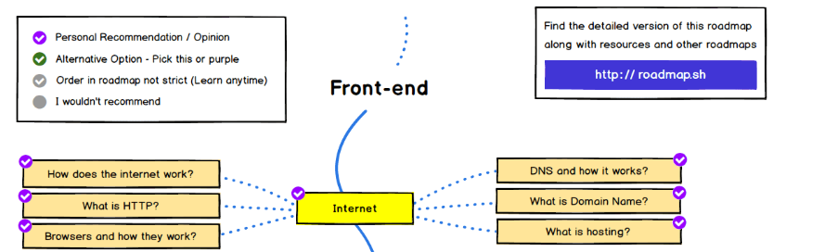
The front-end developer roadmap
Let’s explore and discuss the current roadmap to be a developer today
Learn to become a modern frontend developer
You can read more about the front-end career here:
From Zero to Front-end Hero (Part 1)
From Zero to Front-end Hero (Part 2) - freeCodeCamp.org

Slide 8
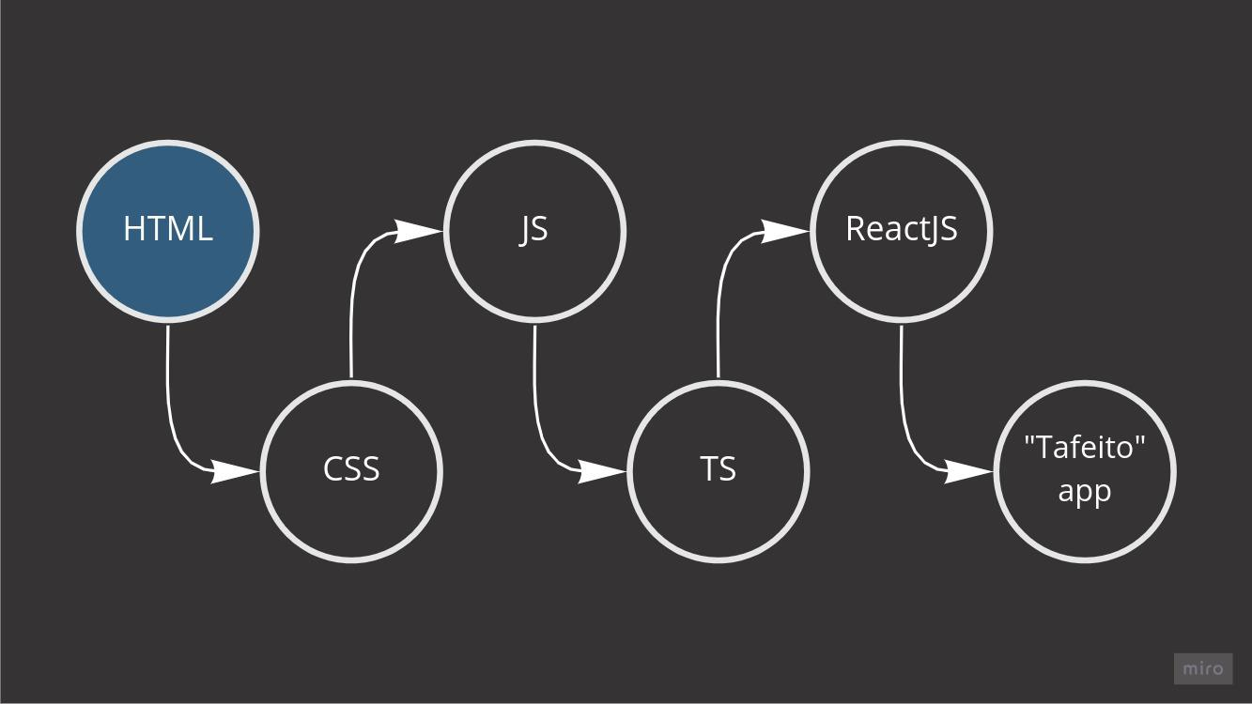
OUR ROADMAP

Slide 9

HTML - Context
HTML - Hypertext markup language
It’s a markup language created to structure what will read and render by web navigator [1].
HTML IS BORN
HTML 2
HTML 3
HTML 4
HTML 5
HTML 5.1
HTML 5.2
1991
NOV 1995
JAN 1997
DEC 1997
OCT
2014
NOV
2016
DEC
2017
[1] https://en.wikipedia.org/wiki/HTML#Transition_of_HTML_Publication_to_WHATWG
TIM BERNERS LEE

Slide 10
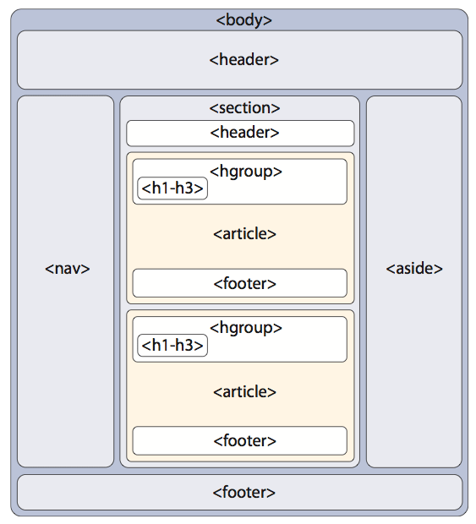
HTML5 - Basic Structure
imagem original de HTML5 & CSS3 - Quick reference. Sergey Movrody

Slide 11
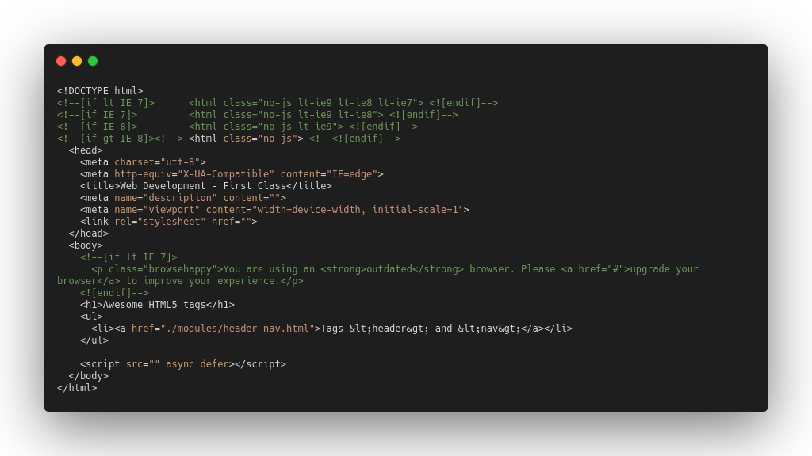
HTML5 - Basic Structure
html version
header (config the doc)
meta: metadata ex: utf-8
title of the page
content of the doc

Slide 12
HTML5 Tags Specifications
Practice
Let’s explore the HTML5 power. We will create a webpage in compliance with the w3c standard and in the end we will validate it.
Page
Follow me on VS Code. We will reproduce the dc website on HTML 5.
Our reference
https://developer.mozilla.org/pt-BR/docs/Web/HTML/Element
How to validate
https://validator.w3.org/nu/

Slide 13

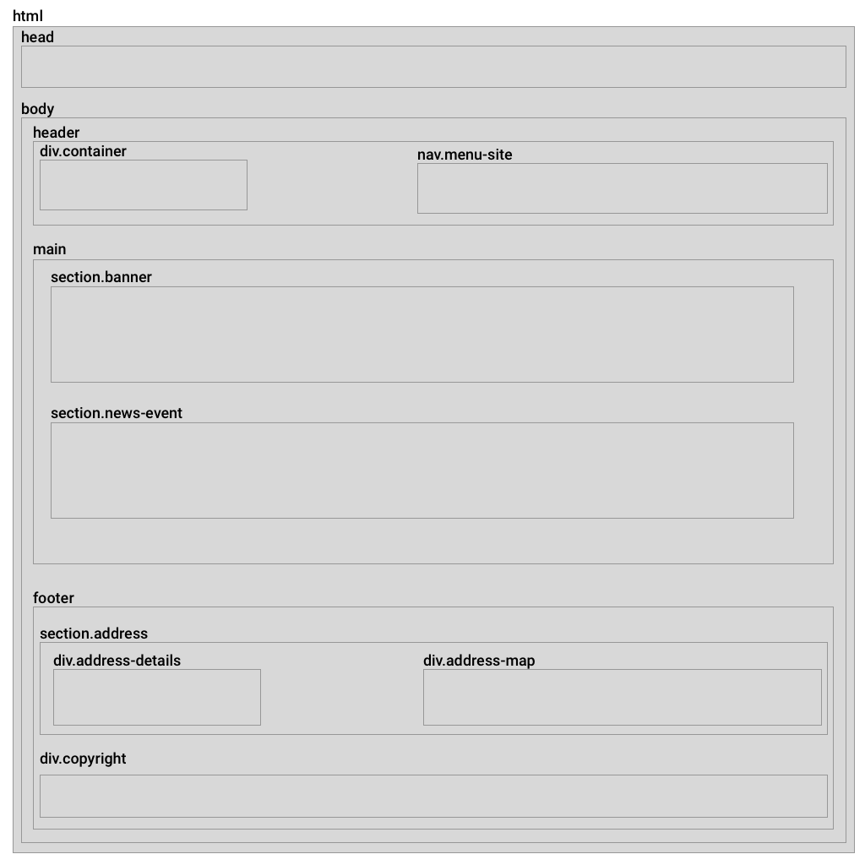
HTML5 Tags Specifications
DC - WEBSITE
HTML Structure

Slide 14

HTML5 Tags Specifications
Exercise
Let’s explore the HTML5 power. We will will make a free interpretation of the DC website and rewrite it on HTML5. In the end we will validate the HTML5 code.
Our tags reference
https://developer.mozilla.org/pt-BR/docs/Web/HTML/Element
How to validate
https://validator.w3.org/nu/

Slide 15

HTML5 Tags Specifications
Activity A1
Enter in your favorite site (or use the dc ufscar website as well) and recreate it using html5 tags.
Deliver the activity on moodle.
You can upload the project or the github project link.

Slide 16
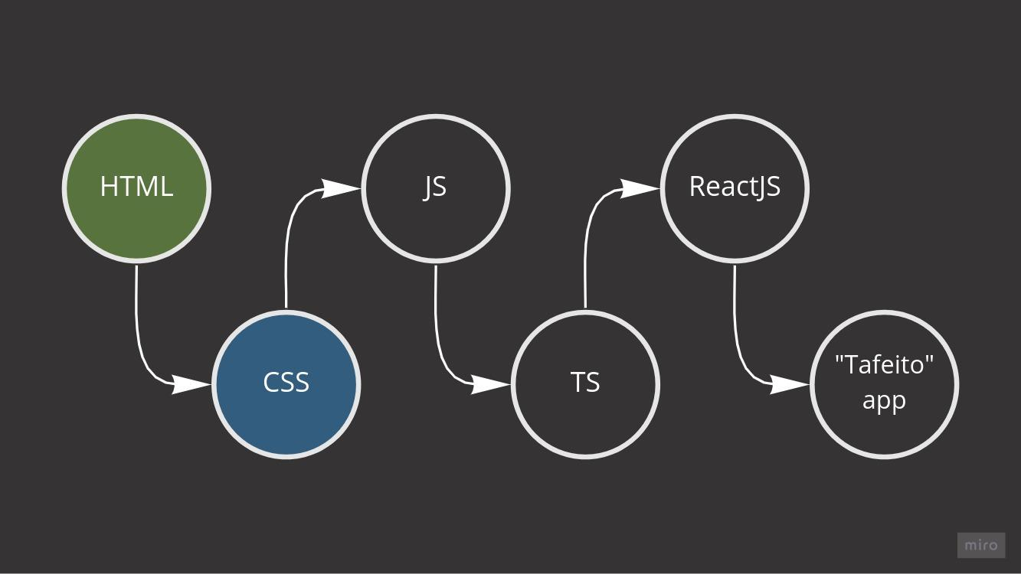
OUR ROADMAP

Slide 17
CSS
Cascading Style Sheets (CSS) is a style sheet language used for describing the presentation of a document written in a markup language like HTML [1].
CSS IS BORN
CSS 2
CSS 2.1
CSS 3
(css3-mediaquery)
modules [1]
DEZ
1996
MAY 1998
JUN 2011
JUN 2012
[1] https://en.wikipedia.org/wiki/Cascading_Style_Sheets#Difficulty_with_adoption

Slide 18
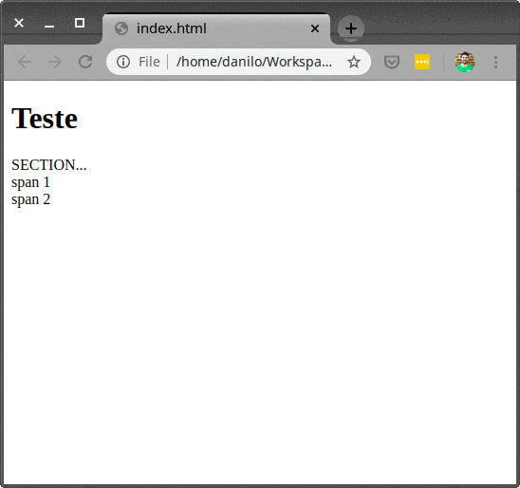
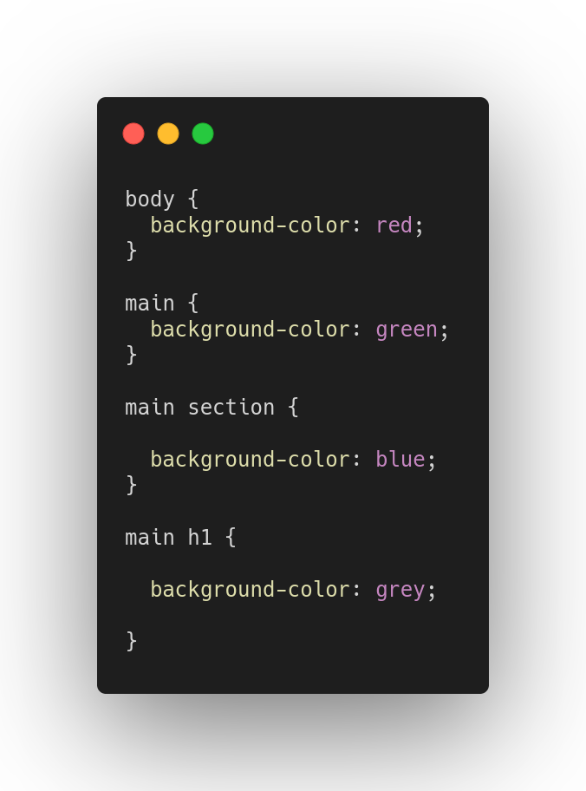
CSS - Basic Concepts
Cascading ... Style Sheets

Slide 19
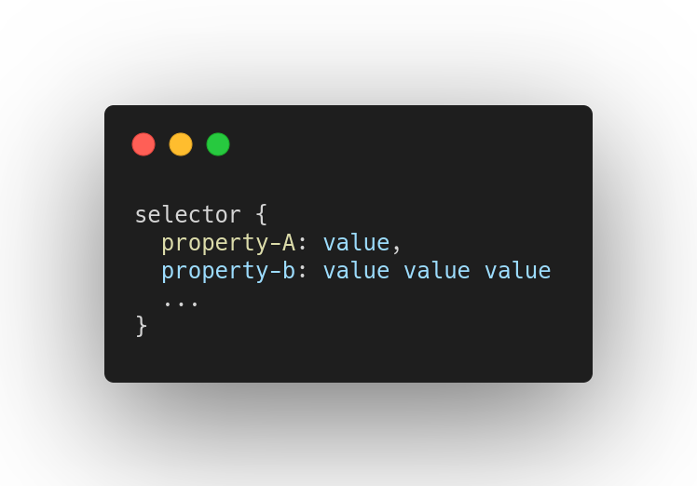
CSS - Selectors
Basic Concepts
Selector: designate what object will be styled
property: designate the style applied to the object

Slide 20
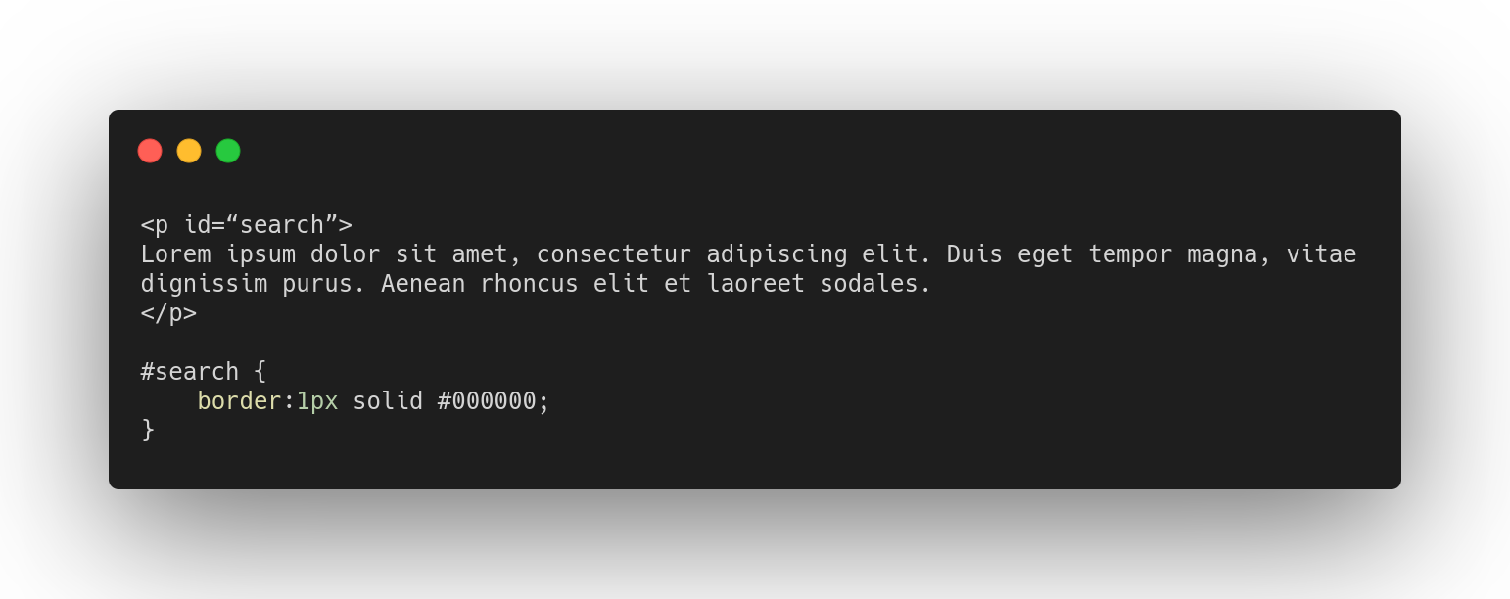
CSS - Selectors
Selector by id

Slide 21
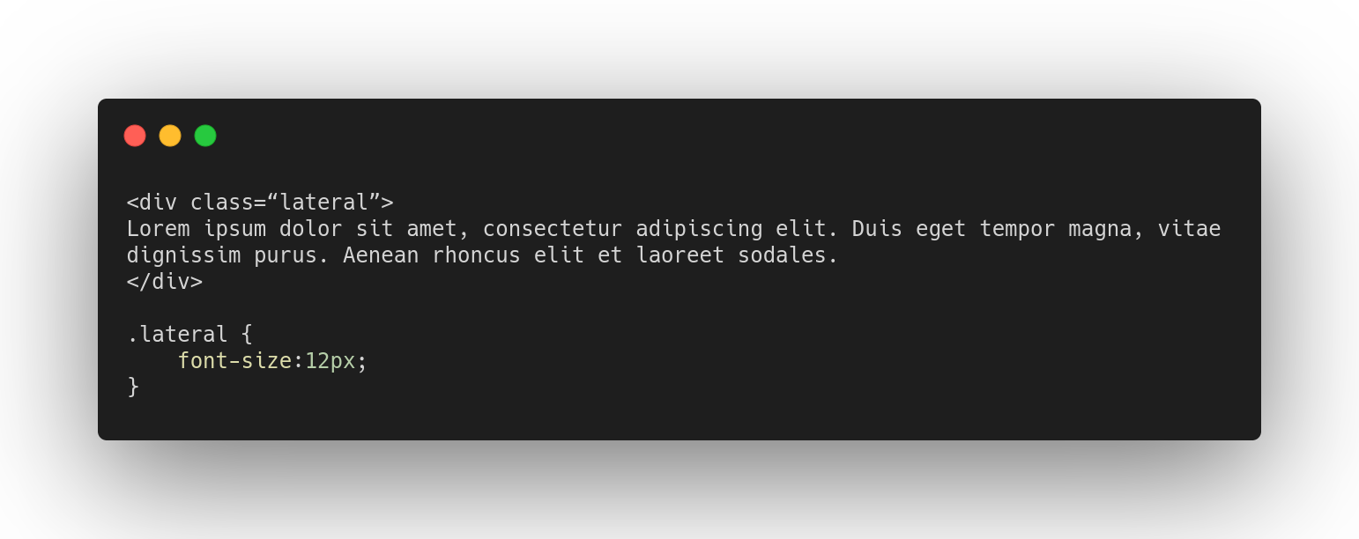
CSS - Selectors
Selector by classname

Slide 22
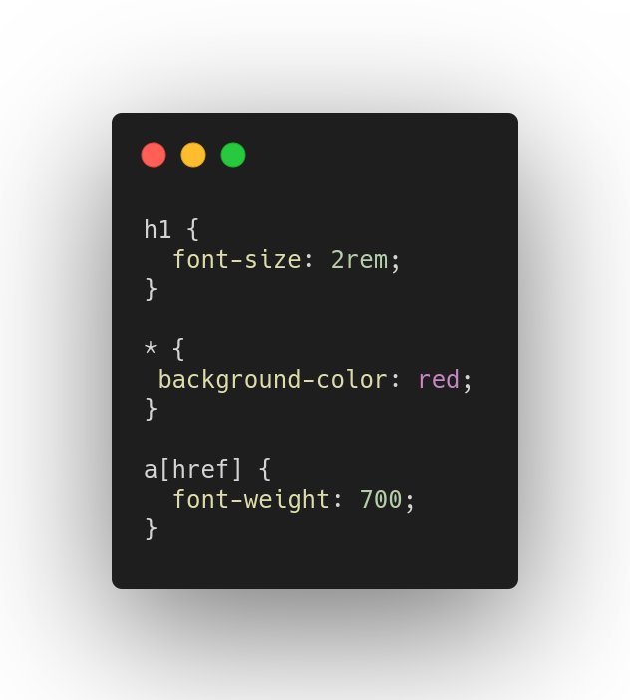
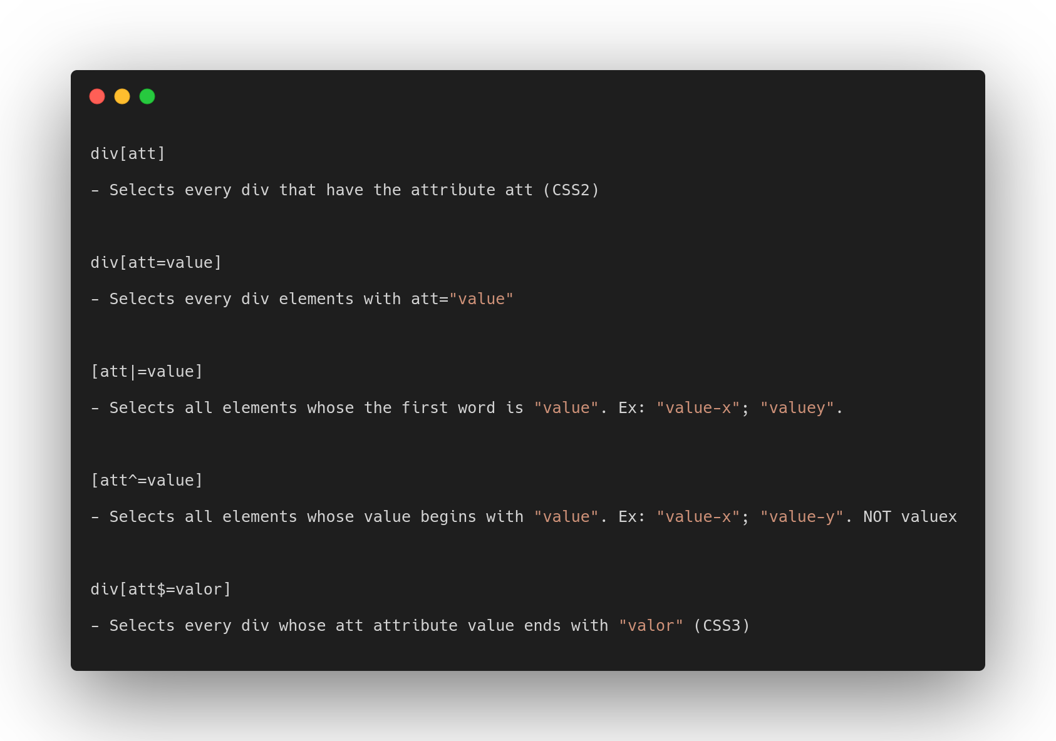
CSS - Selectors
Selector by type, universal and attribute
More attributes selectors

Slide 23
CSS - Selectors
Mastering the selectors is a key skill to develop a high-quality CSS code.
There are more than 50 available selectors. You can check and understand all available selectors HERE.
EXTRA:
If you understand CSS, you will be easy to develop web crawlers and extract content from the web!

Slide 24
CSS - Properties
Properties are the style definition.
There are more than 500 available properties.
You can check and understand all* available properties HERE.
* there is no guarantee that this site are listing all properties.

Slide 25
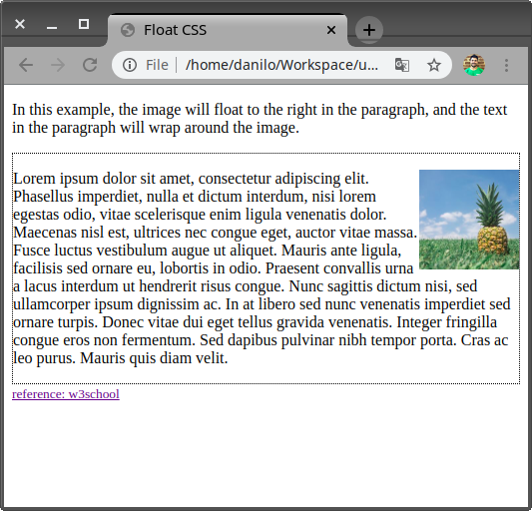
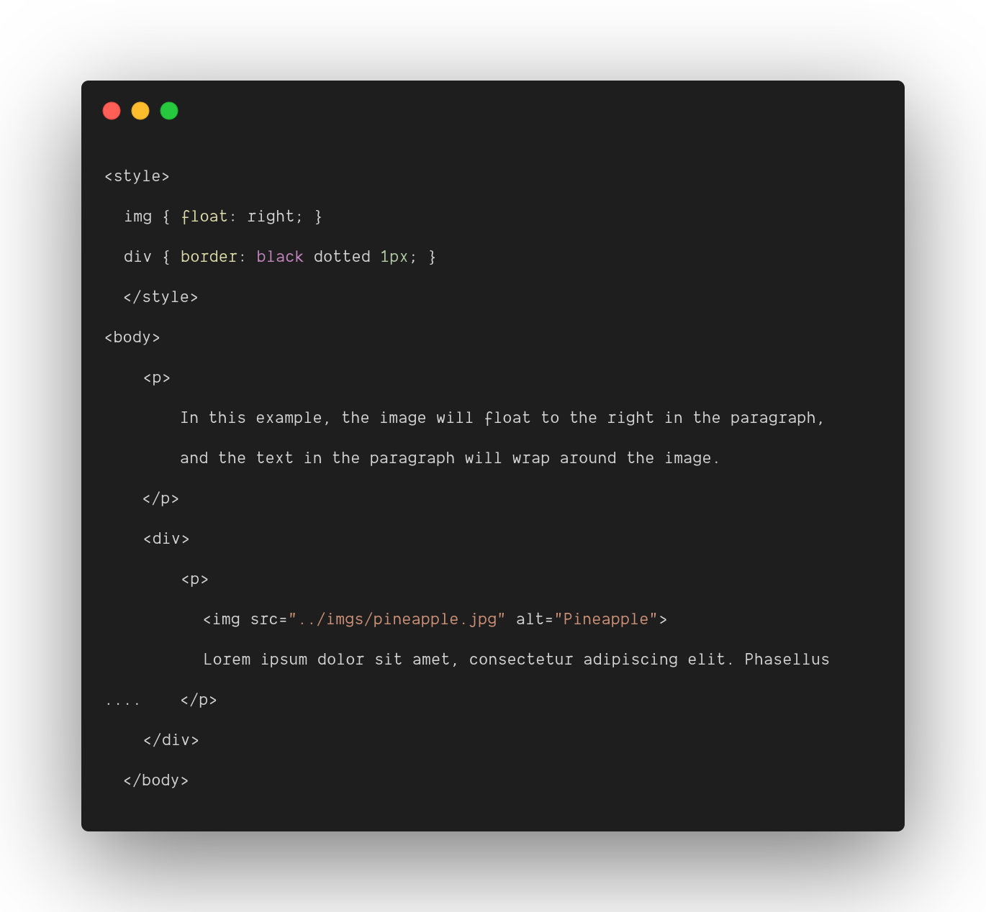
CSS - Layouts
Float

Slide 26
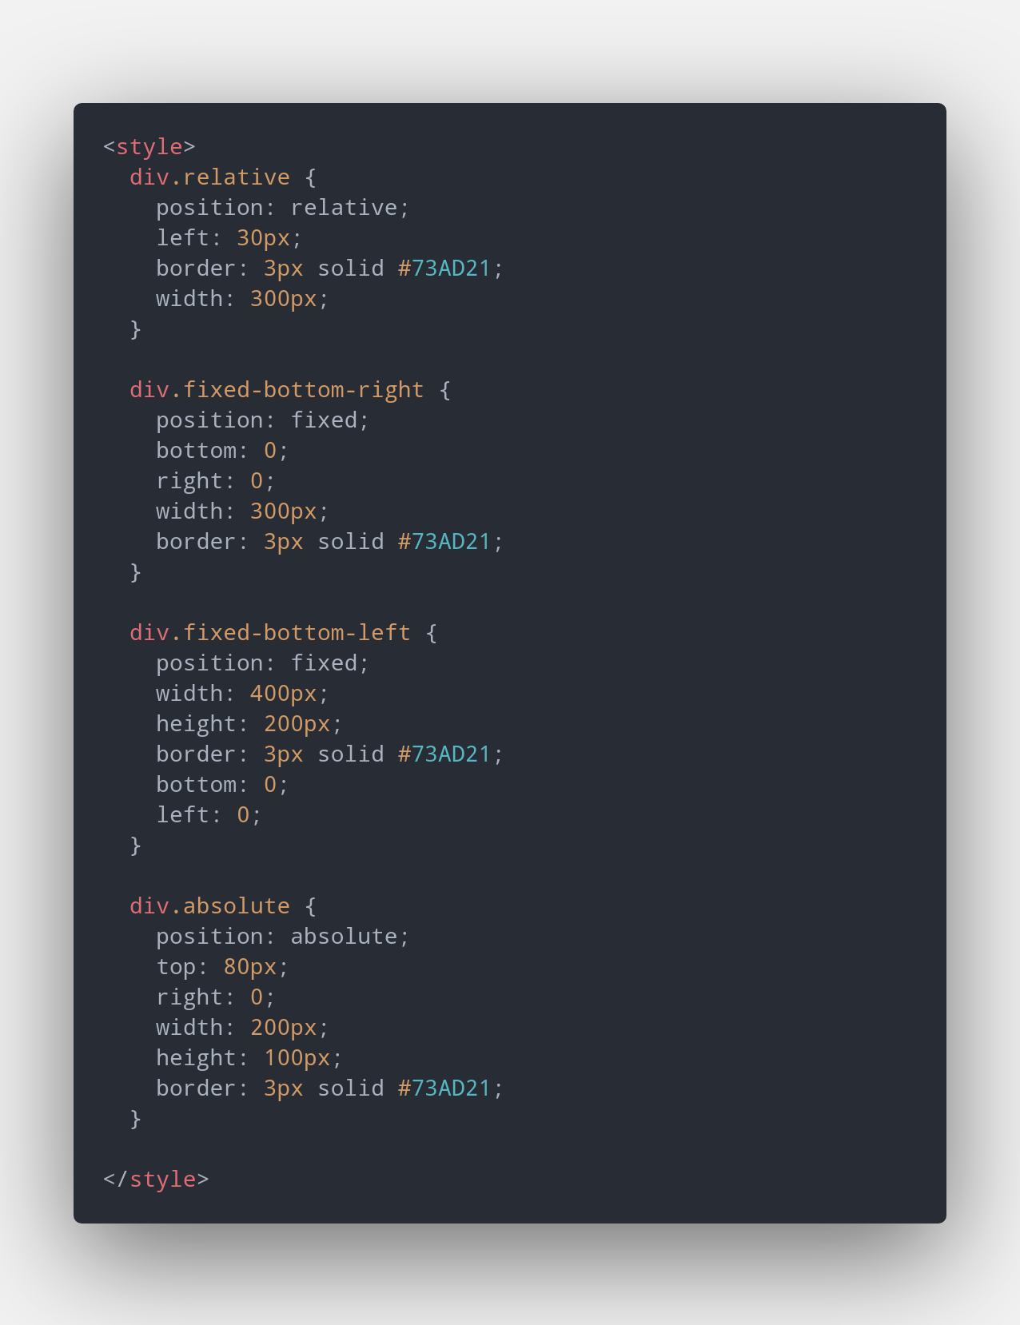
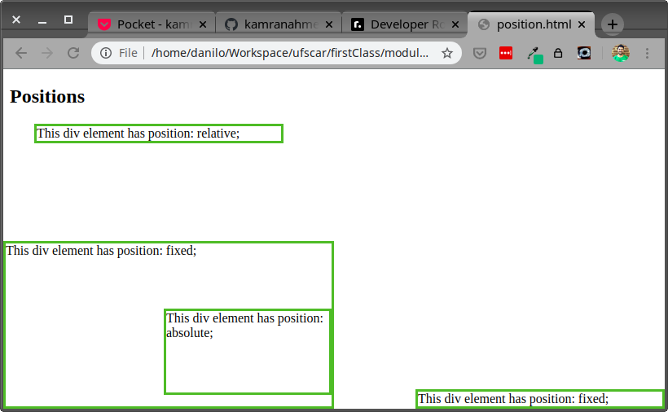
CSS - Layouts
Positioning
Notes:
An element with position: relative; is positioned relative to its normal position:</p>
An element with position: fixed; is positioned relative to the viewport, which means it always stays in the same place even if the page is scrolled:

Slide 27
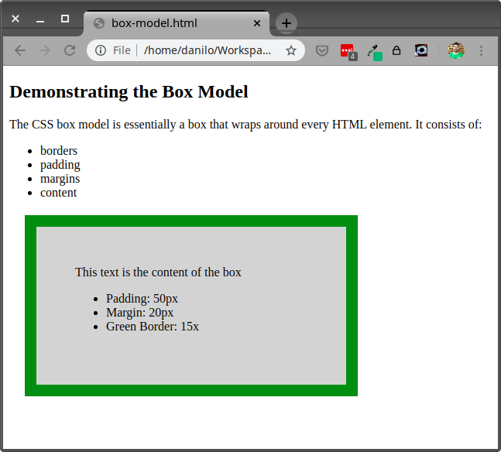
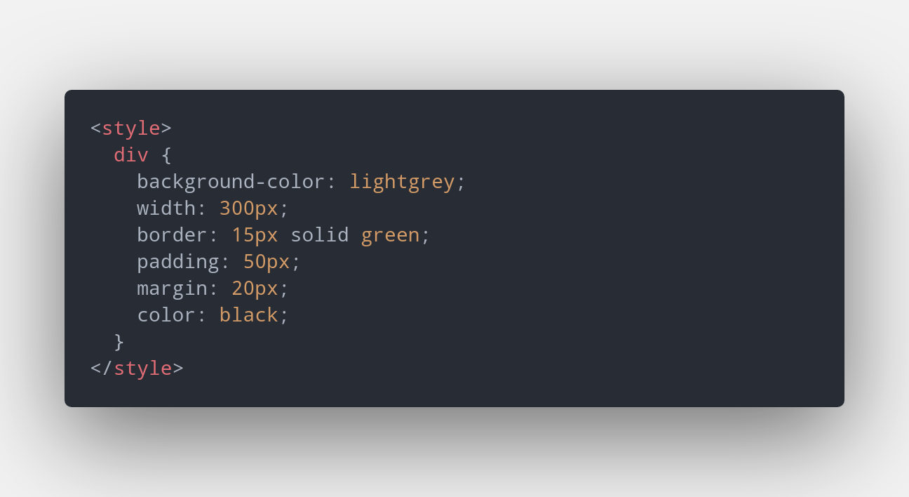
CSS - Layouts
Box Model

Slide 28
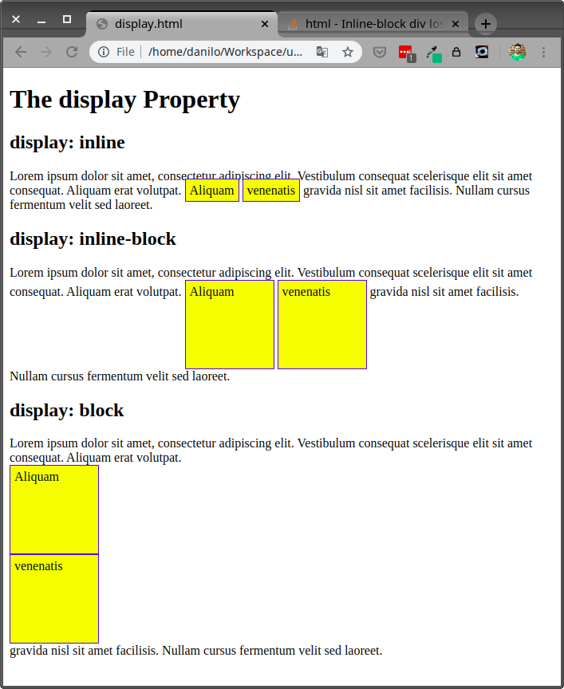
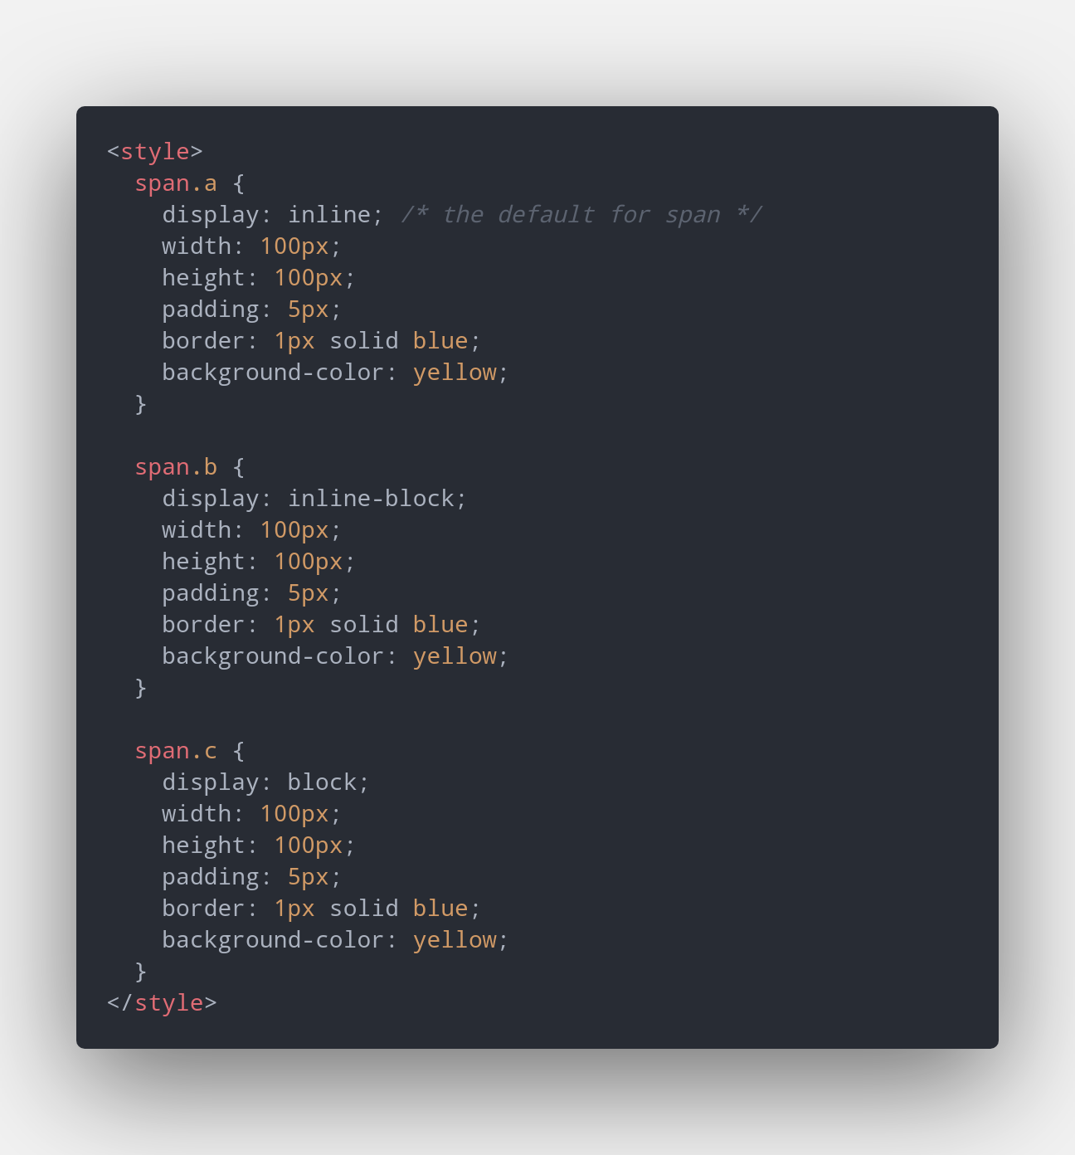
CSS - Layouts
Display

Slide 29
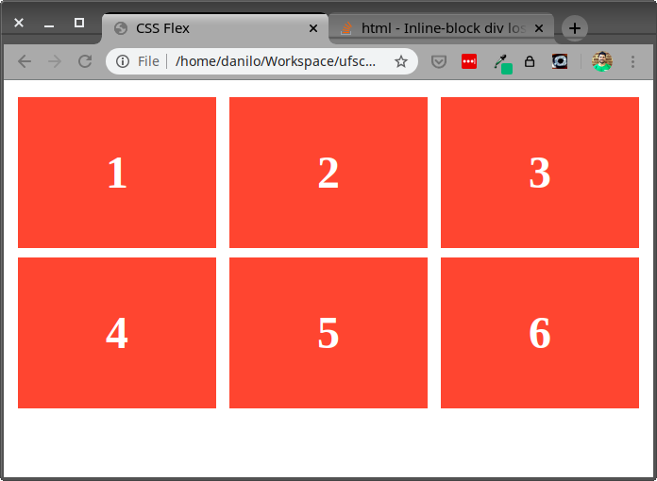
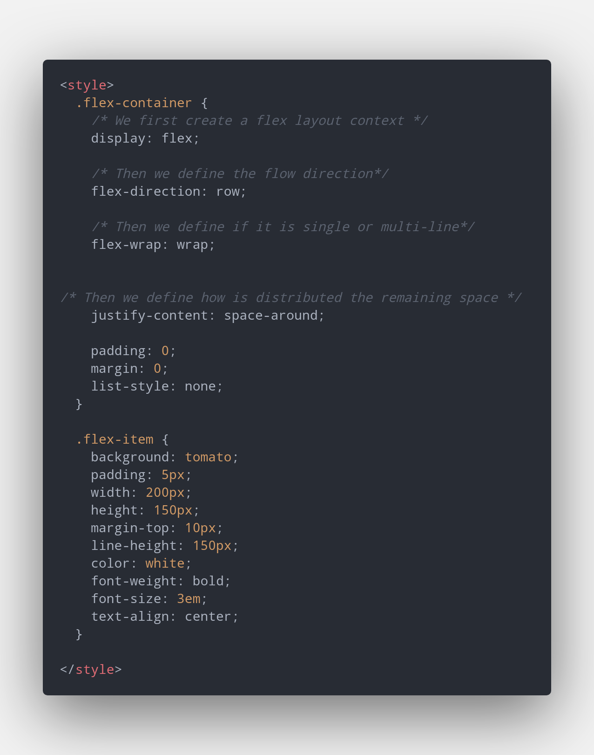
CSS - Layouts
FlexBox

Slide 30
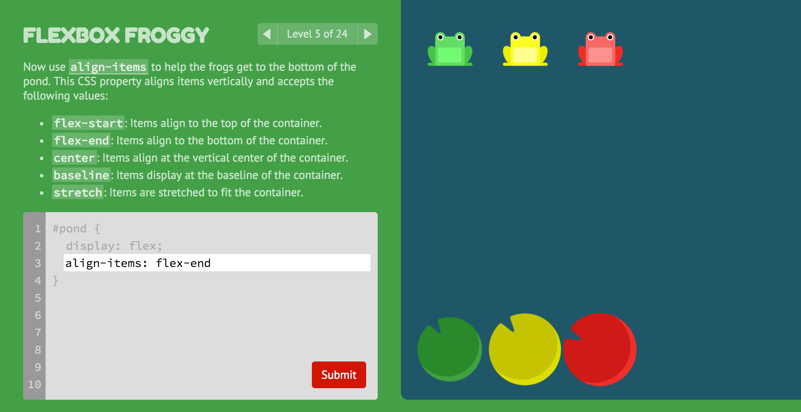
CSS - Layouts
Exercise
Let’s practice flexbox
FlexBox
LINK
Notes:
Additional link https://flukeout.github.io/

Slide 31
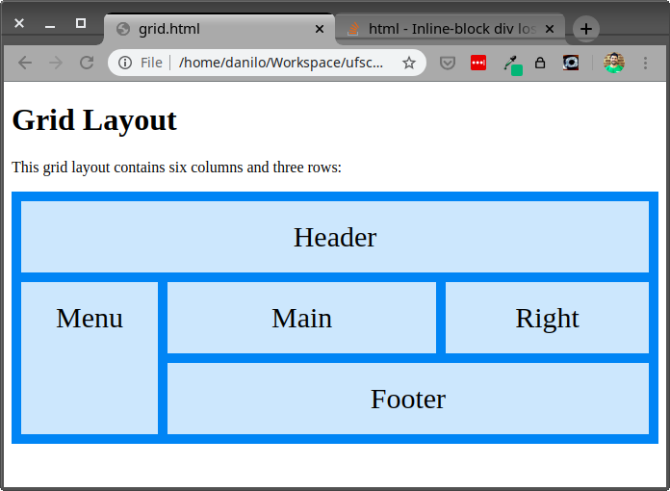
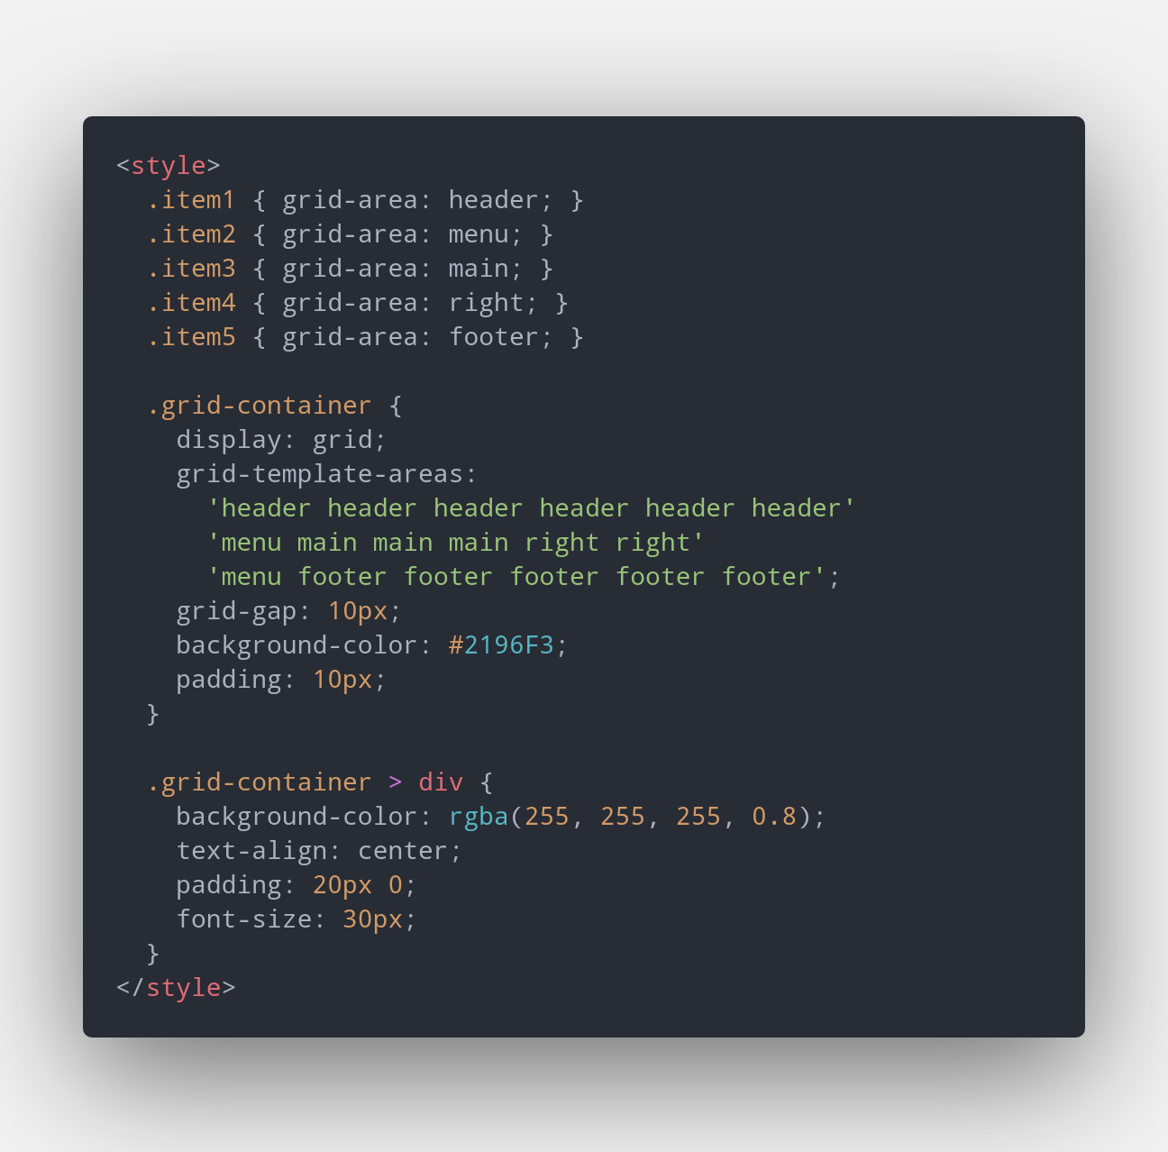
CSS - Layouts
CSS Grid
CSS Availability https://caniuse.com/#search=css-grid

Slide 32
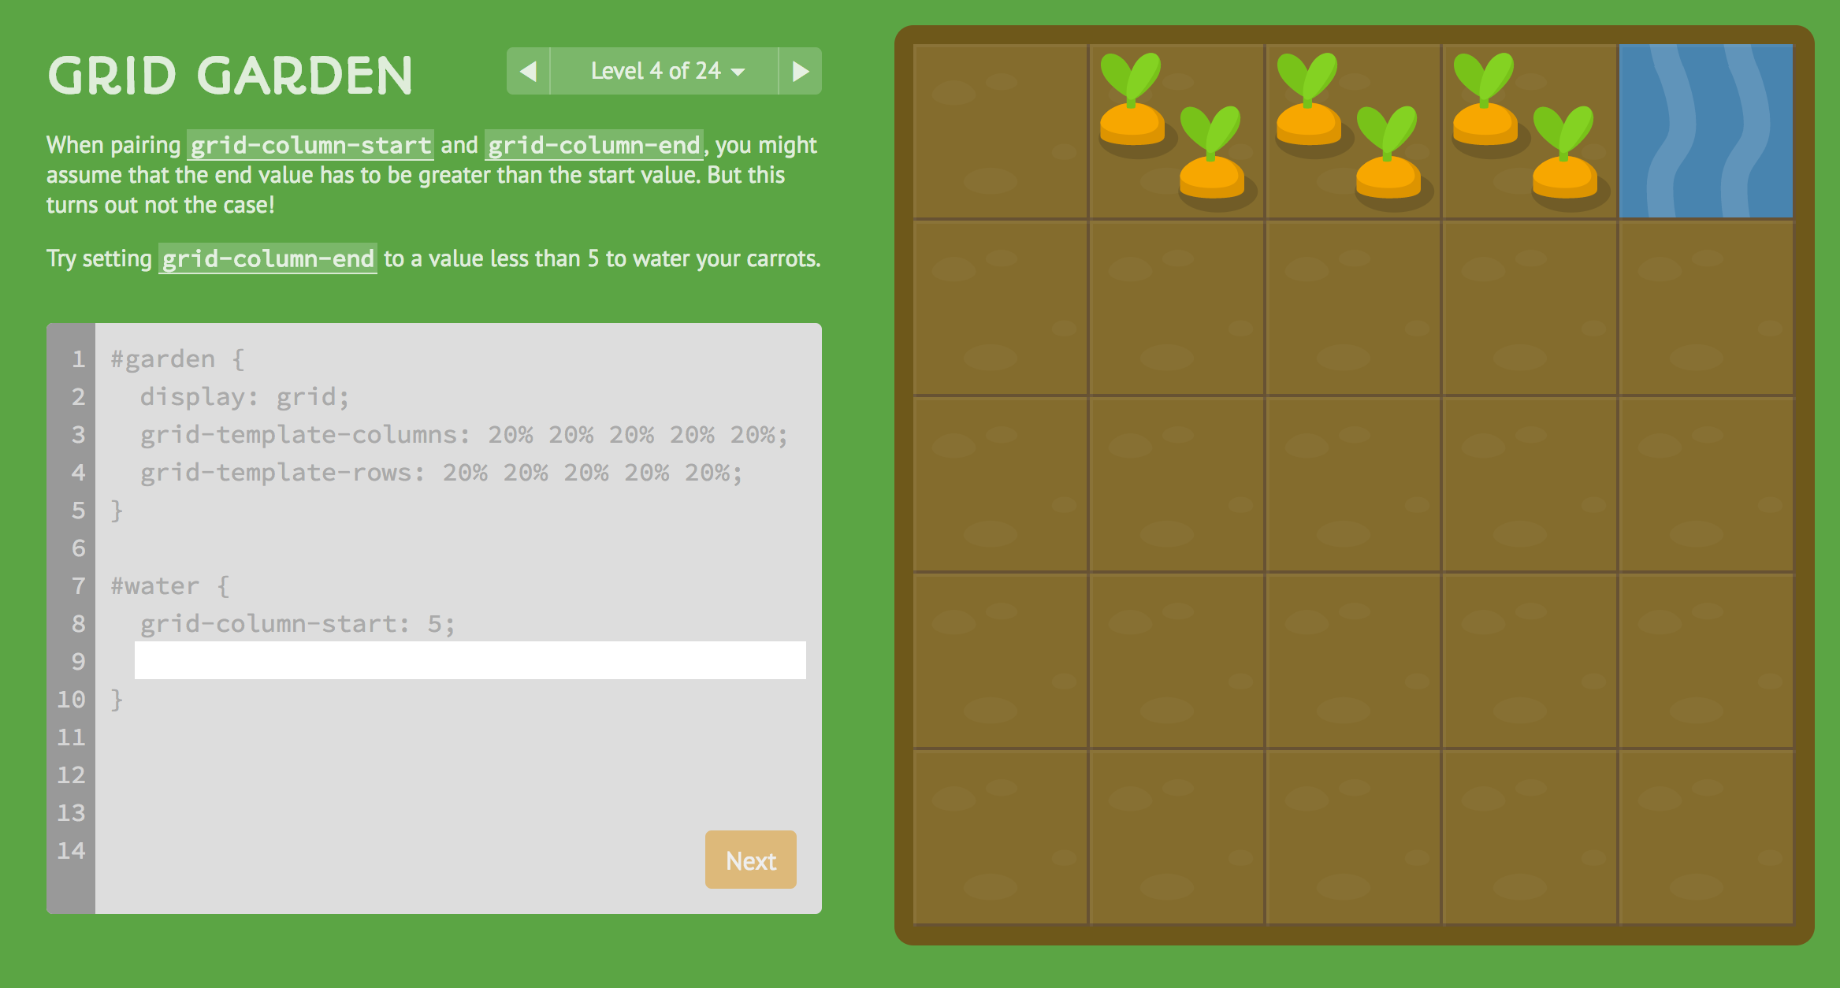
CSS - Layouts
Exercise
Let’s practice css grid
CSS Grid
LINK

Slide 33
CSS - Media Query and Responsive Design
“A media query consists of a media type and at least one expression that limits the style sheets' scope by using media features, such as width, height, and color.”[1]
“Responsive design refers to apps and websites that adapt to mobile, tablet, and desktop devices. When it comes to web accessibility, the WCAG 2.0 - Web Content Accessibility Guidelines specifically indicates that websites must be accessible on all screens all the way down to 320px in width, and functional when zoomed to 200%.”[2]
[1] https://developer.mozilla.org/de/docs/Web/CSS/Media_Queries/Using_media_queries
[2] https://uxtricks.design/blogs/ux-design/accessibility-standards/

Slide 34
CSS - Media Query and Responsive Design
<meta name="viewport" content="width=device-width, initial-scale=1">
width=device-width
Mobile browsers will by default render the site at a desktop screen width and then try to make that content look better by increasing font sizes and scaling the content. This setting instructs the browser to set the width to the actual device width and reflow content according to the actual screen size.
initial-scale=1
When changing the orientation of the device, mobile browsers will keep the page width constant and zoom into the content. This attribute instructs the browser to use a 1:1 relationship between CSS pixels and device pixels regardless of orientation.[1]
[1]https://gist.github.com/mdang/50e5fa253597f91139ac

Slide 35
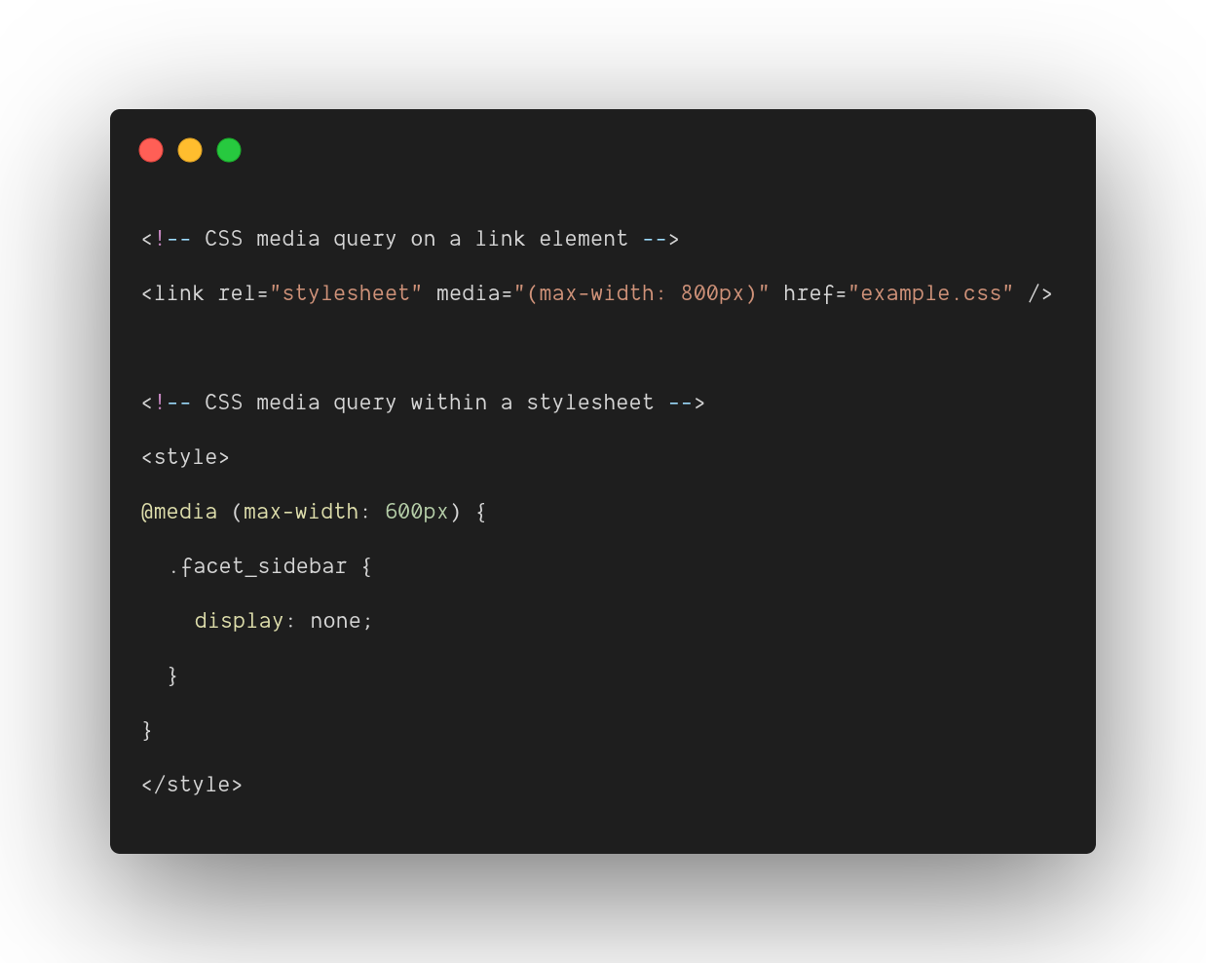
CSS - Media Query and Responsive Design
Media query
Example
https://developer.mozilla.org/de/docs/Web/CSS/Media_Queries/Using_media_queries

Slide 36
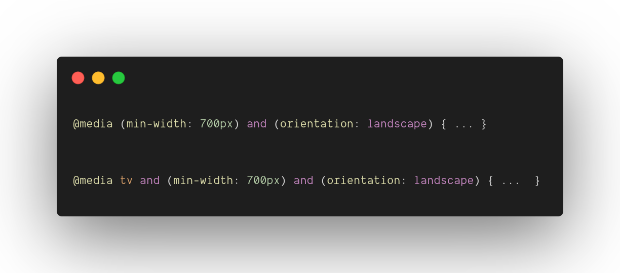
CSS - Media Query and Responsive Design
Media query
Operator and
The and keyword is used for combining multiple media features together, as well as combining media features with media types.
https://developer.mozilla.org/de/docs/Web/CSS/Media_Queries/Using_media_queries

Slide 37
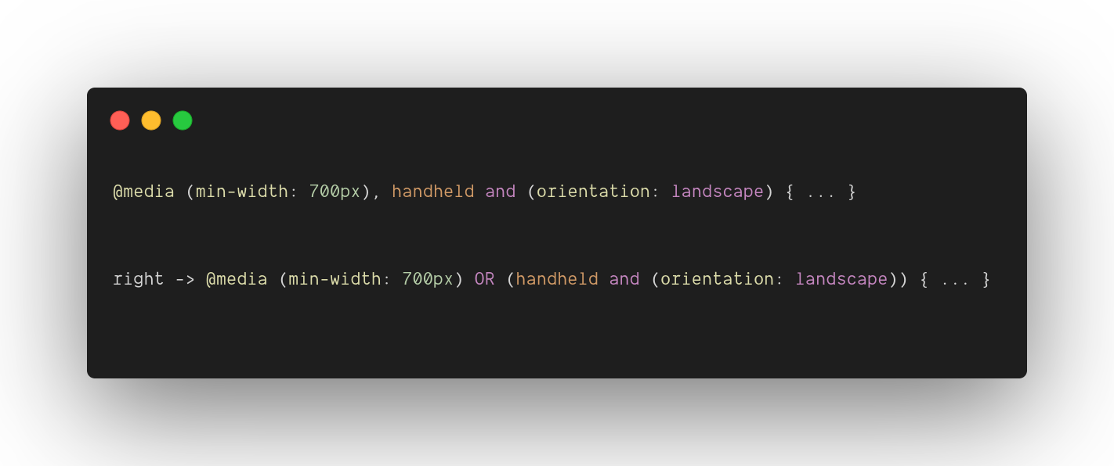
CSS - Media Query and Responsive Design
Media query
Operator comma-separated lists (or)
Comma-separated lists behave like the logical operator or when used in media queries. When using a comma-separated list of media queries, if any of the media queries returns true, the styles or style sheets get applied.
https://developer.mozilla.org/de/docs/Web/CSS/Media_Queries/Using_media_queries

Slide 38
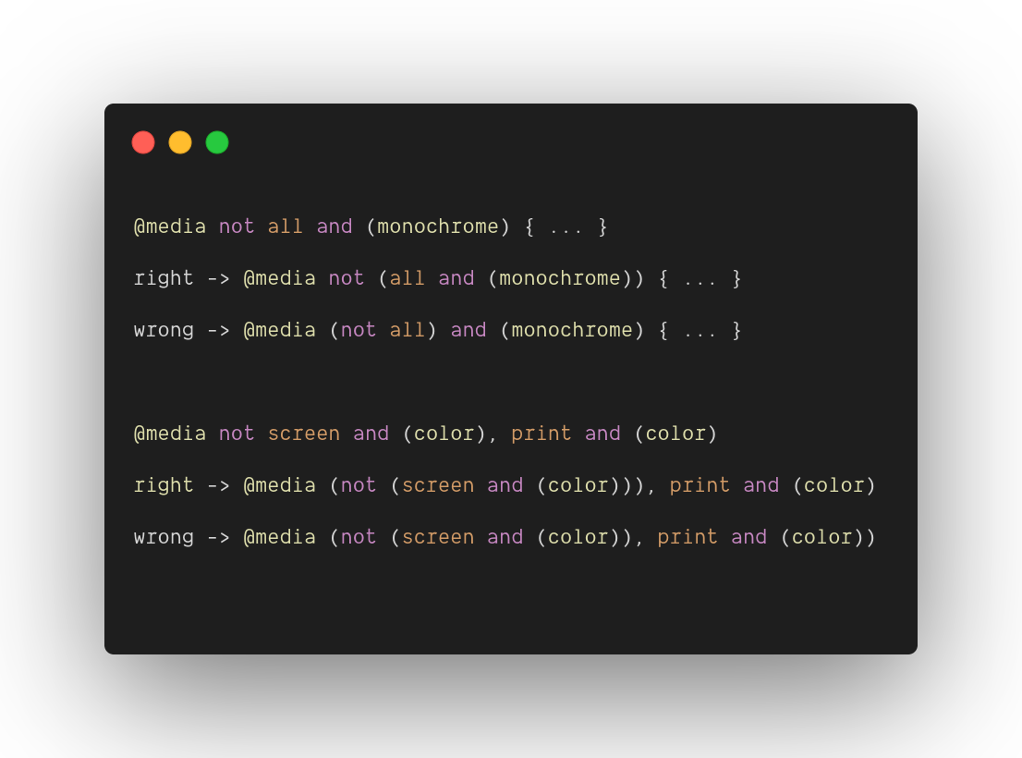
CSS - Media Query and Responsive Design
Media query
Operator not
The not keyword applies to the whole media query and returns true if the media query would otherwise return false
https://developer.mozilla.org/de/docs/Web/CSS/Media_Queries/Using_media_queries

Slide 39
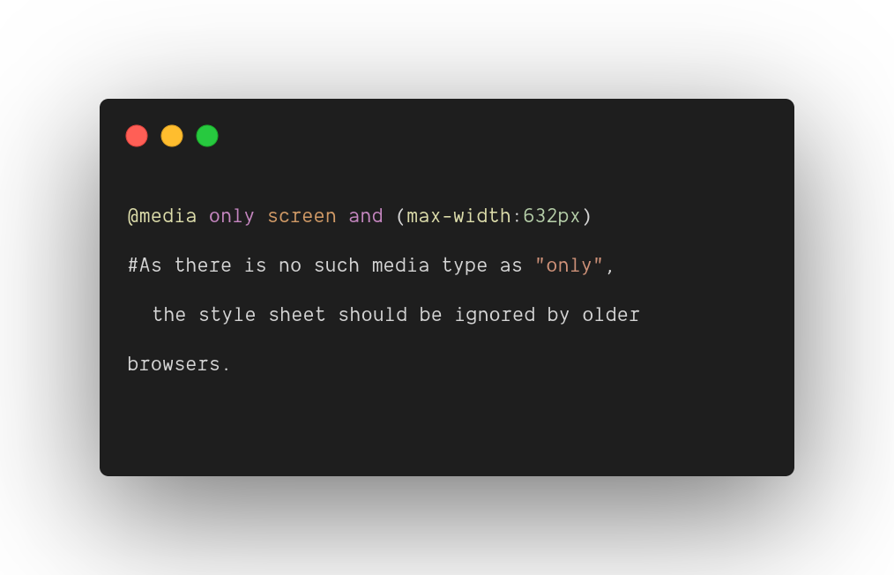
CSS - Media Query and Responsive Design
Media query
only
The only keyword prevents older browsers that do not support media queries with media features from applying the given styles
https://developer.mozilla.org/de/docs/Web/CSS/Media_Queries/Using_media_queries

Slide 40


CSS - Media Query and Responsive Design
Lets Convert the the homepage to be responsive (MyHome)
We will use the responsively-app: A modified browser that helps in responsive web development. to help us in this activity.
Exercise

Slide 41
CSS
Activity A2
Finish the flexbox and cssgrid challenges.
(Take a Printscreen with all phases checked and upload it to Moodle)

Slide 42
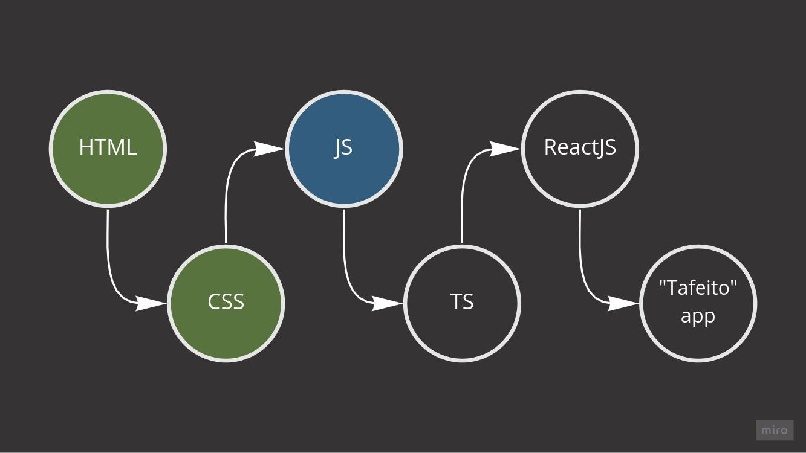
OUR ROADMAP

Slide 43

JS
JavaScript often abbreviated as JS, is a programming language that conforms to the ECMAScript specification. JavaScript is high-level, often just-in-time compiled, and multi-paradigm [1].
cancelled
ECMA 5
ECMA 6 ES 2015
JS IS BORN
ECMA
ECMA
2
ECMA 3
ECMA 4
ECMA 7
ES 2016
ECMA 8
ES 2017
ECMA 9
ES 2018
ECMA 10
ES 2019
ECMA 11
ES 2020
ECMA 12
ES 2021
Dez
1995
JUN
1997
JUN
1998
DEC 1999
2004
DEC 2009
JUN 2015
JUN 2016
JUN 2017
JUN 2018
JUN 2019
JUN 2020
JUN 2021
[1] https://en.wikipedia.org/wiki/ECMAScript Learn More: https://www.swyx.io/writing/js-third-age/
Notes:
“ ES4 effort faltered amidst strong competition from closed ecosystems like Flash/Actionscript. “
Primeira onda até 2004-> Concepção
Segunda onda de 2009 a 2019 -> crescimento e expansão
Terceira onda: es modules (snowpack; IE11 will lost its support; Typescript;

Slide 44
JS - More context
JS is a language whose implement the ECMAScript specification
Each browser is responsible to adapt and support the ECMAScript specification (CSS analogy)
You can check more here:
ECMAScript 6 compatibility table
ECMAScript 6: New Features: Overview and Comparison
ES6 in Depth articles on Pony Foo
swyx Writing | The Third Age of JavaScript
If you don’t have anything to do in a sunny sunday, you can read the spec yourself
tc39/ecma262: Status, process, and documents for ECMA-262

Slide 45
JS - The Basics
JS and the browser interaction
<script src="script.js">
<script defer src="script.js">
<script async src="script.js">
html
parsing
html
parsing
script fetch
html
parsing
pause
script fetch
script fetch
script
execution
script
execution
script
execution
html
parsing

Slide 46
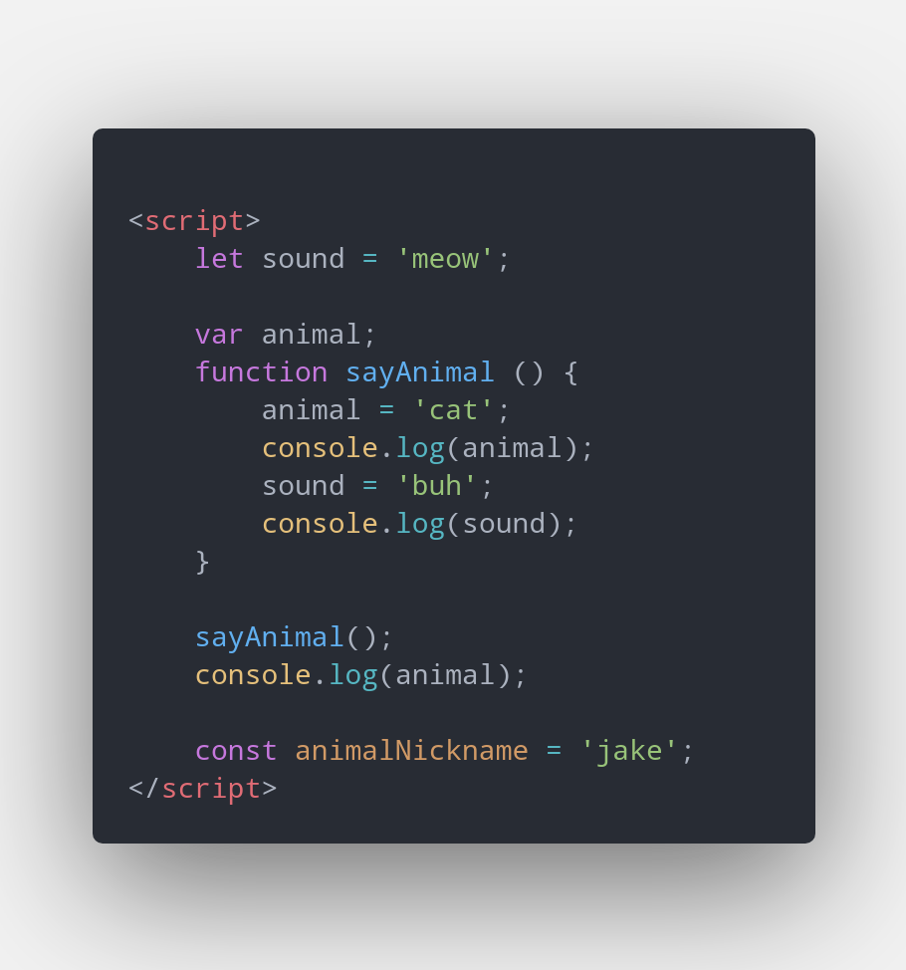
JS - ES6
Scope
Scope determines the accessibility (visibility) of variables.
In JavaScript there are two types of scope:
Local scope
Global scope
JavaScript has function scope: Each function creates a new scope.
Scope determines the accessibility (visibility) of these variables.
Variables defined inside a function are not accessible (visible) from outside the function.
https://www.w3schools.com/js/js_scope.asp
Notes:
Em JavaScript somente funções tem escopo, se criar uma variável dentro de if passa a ser acessada por todo restante da função.

Slide 47
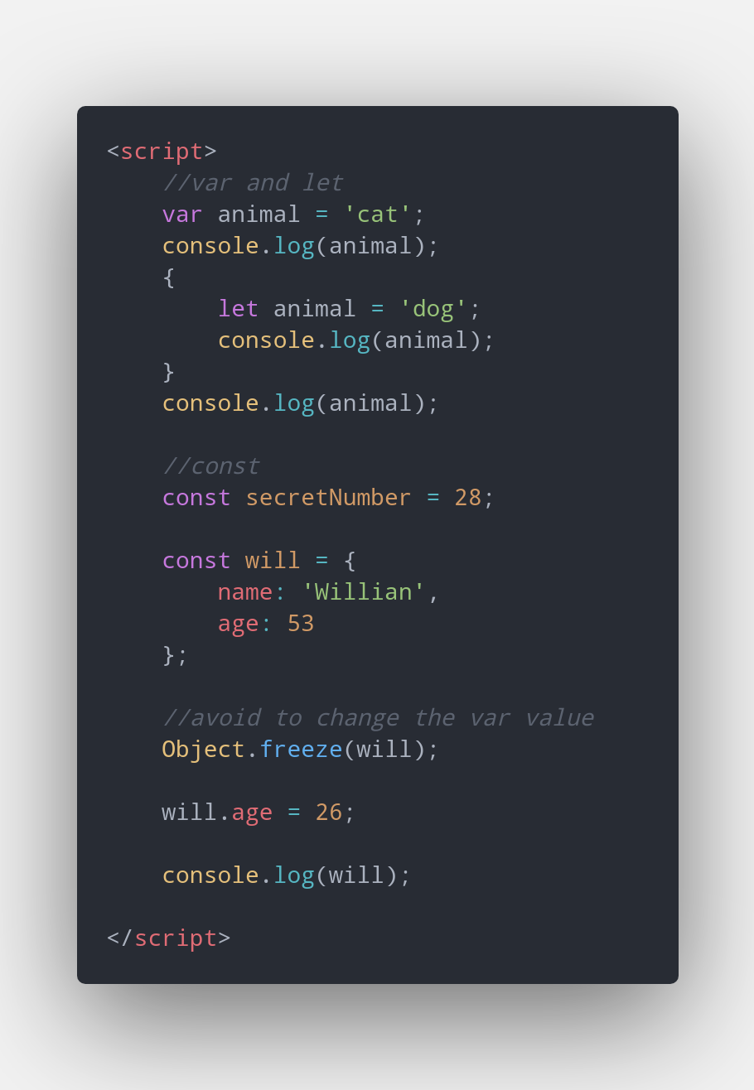
JS - ES6
Variables var, let and const
var declarations are globally scoped or function scoped while let and const are block scoped.[1]
var variables can be updated and re-declared within its scope;
let variables can be updated but not re-declared;
const variables can neither be updated nor re-declared.[1]
They are all hoisted to the top of their scope. But while var variables are initialized with undefined, let and const variables are not initialized.
While var and let can be declared without being initialized, const must be initialized during declaration.
[1] https://www.freecodecamp.org/news/var-let-and-const-whats-the-difference/#:~:text=var%20declarations%20are%20globally%20scoped%20or%20function%20scoped%20while%20let,the%20top%20of%20their%20scope.

Slide 48
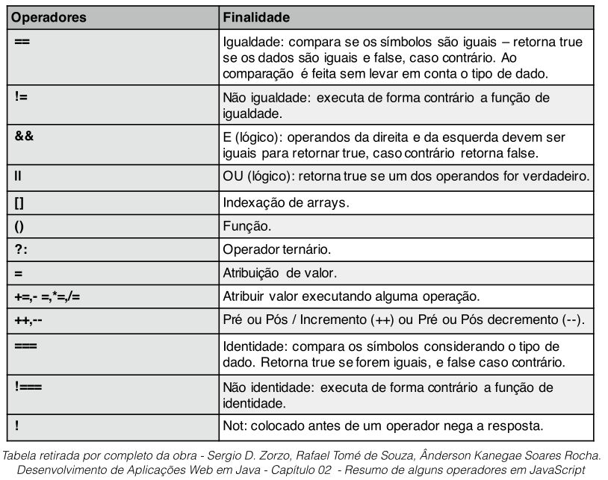
JS - ES6
Operators
You can explore more about the trick JS operators logic.
denysdovhan/wtfjs: A list of funny and tricky JavaScript examples

Slide 49
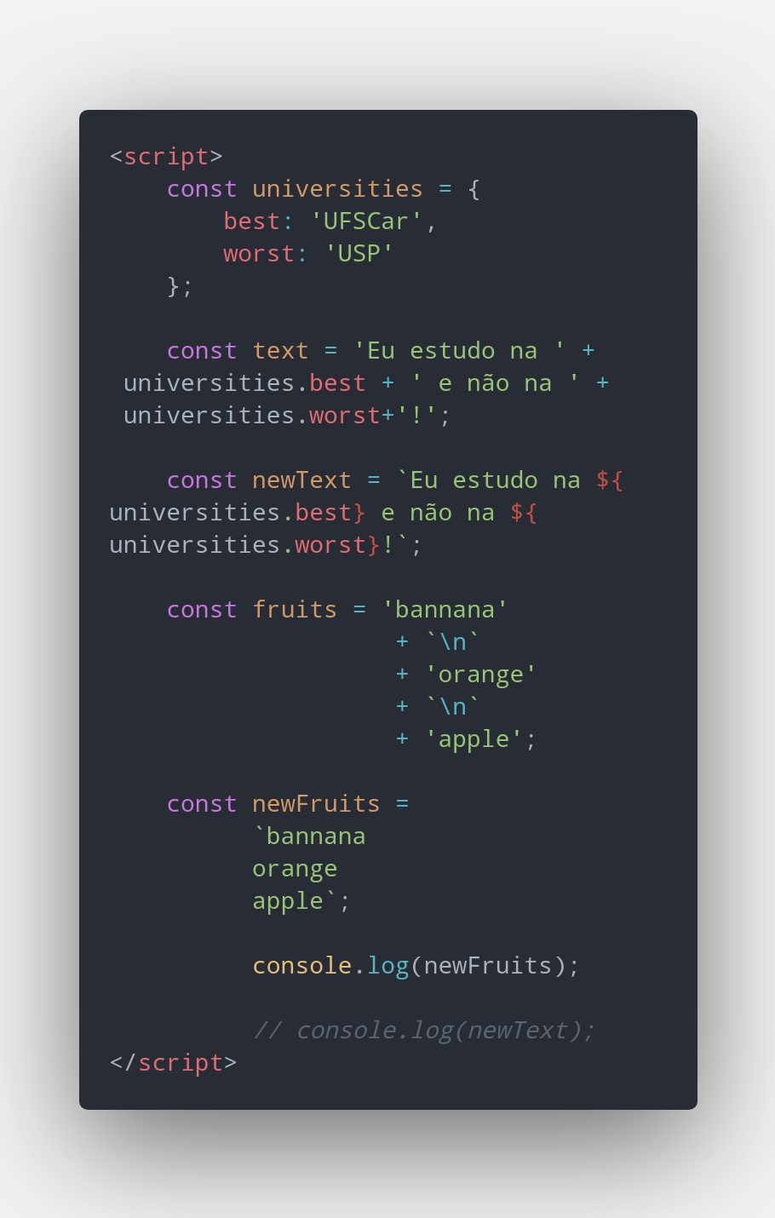
JS - ES6
Template Literals
A template literal is a new kind of string literal that can span multiple lines and interpolate expressions (include their results).

Slide 50
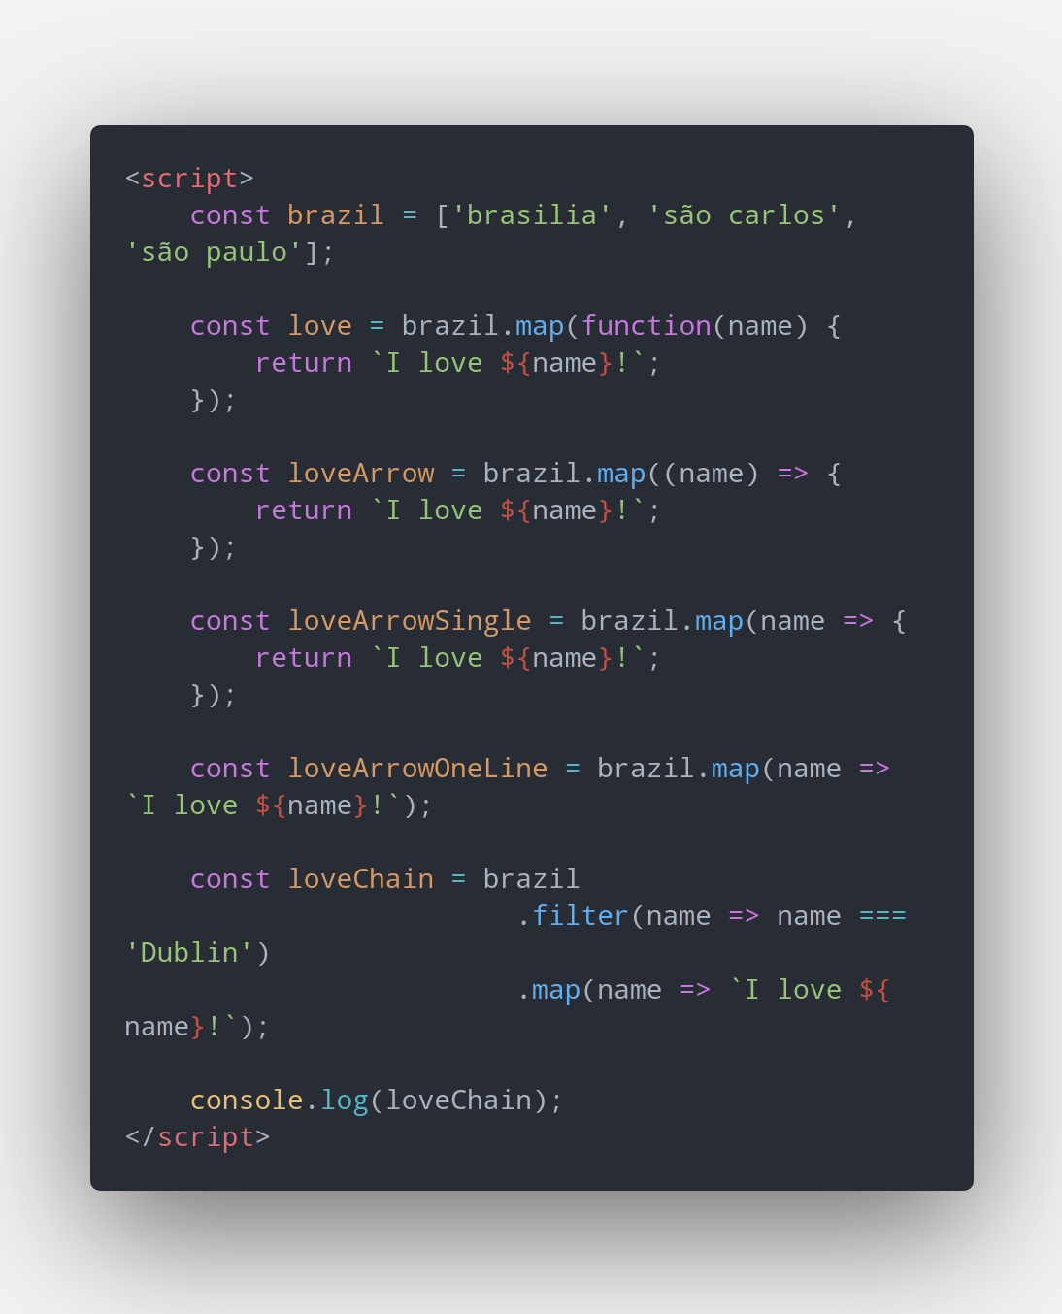
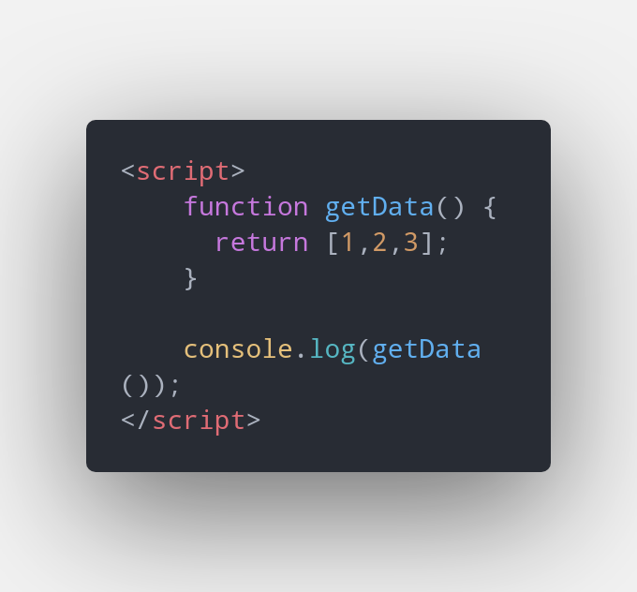
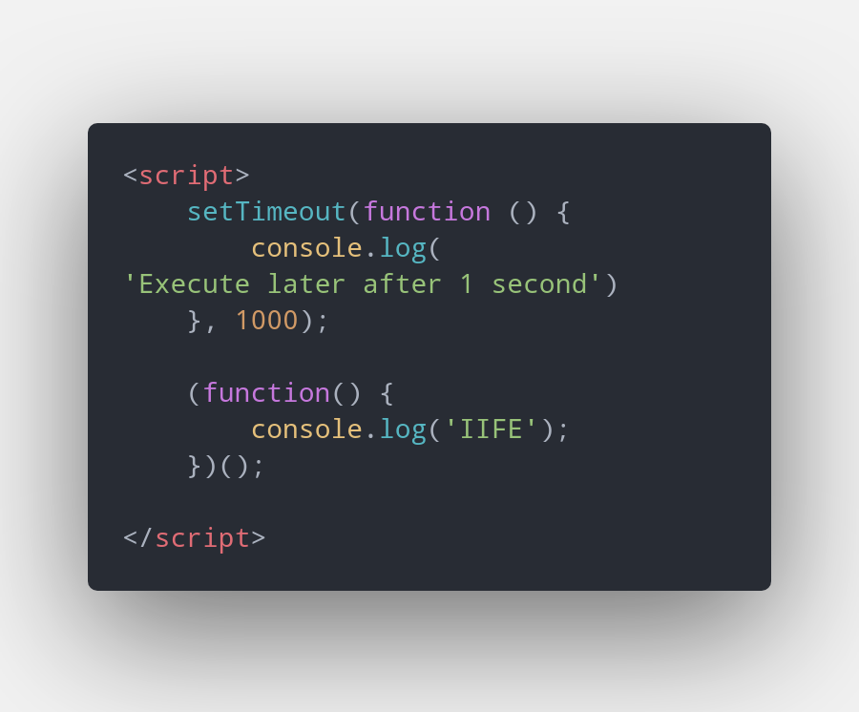
JS - ES6
Functions
Literal
Anonymous
Arrow function

Slide 51
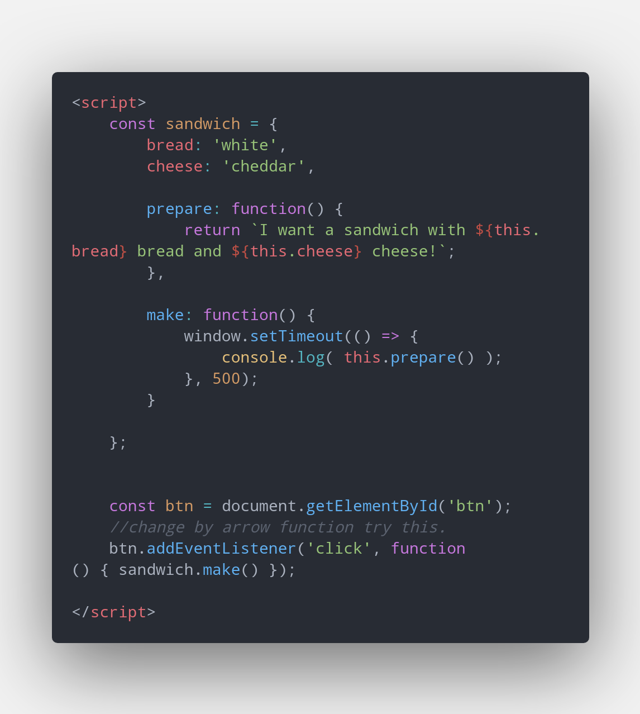
JS - ES6
Lexical This on Arrow Function and function
Before arrow functions, every new function defined its own this value based on how the function was called:
A new object in the case of a constructor undefined in strict mode function calls. The base object if the function was called as an "object method". etc.
https://developer.mozilla.org/en-US/docs/Web/JavaScript/Reference/Functions/Arrow_functions

Slide 52
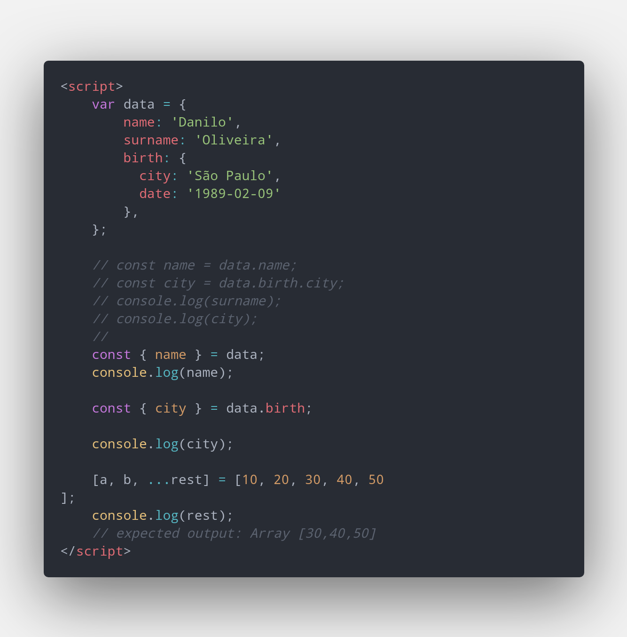
JS - ES6
Destructuring
The destructuring assignment syntax is a JavaScript expression that makes it possible to unpack values from arrays, or properties from objects, into distinct variables.
https://developer.mozilla.org/en-US/docs/Web/JavaScript/Reference/Operators/Destructuring_assignment

Slide 53
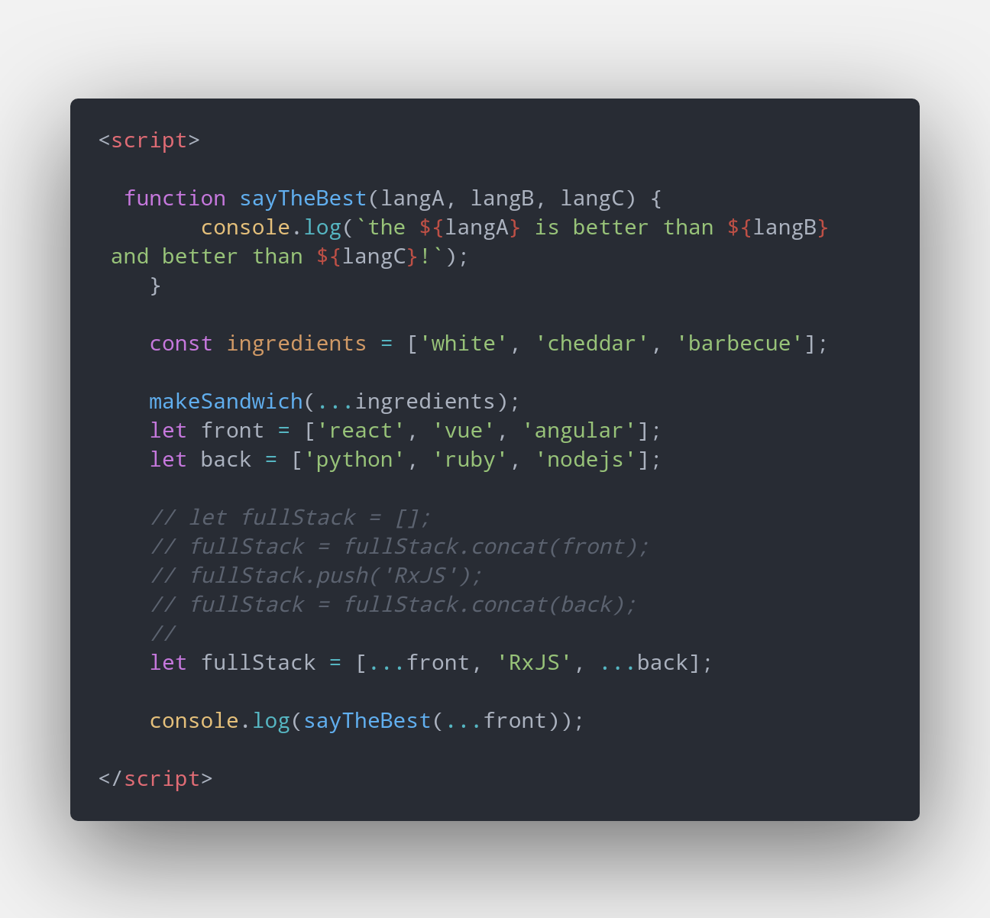
JS - ES6
Spread Operator
Spread syntax allows an iterable such as an array expression or string to be expanded in places where zero or more arguments (for function calls) or elements (for array literals) are expected, or an object expression to be expanded in places where zero or more key-value pairs (for object literals) are expected.
https://developer.mozilla.org/en-US/docs/Web/JavaScript/Reference/Operators/Spread_syntax

Slide 54
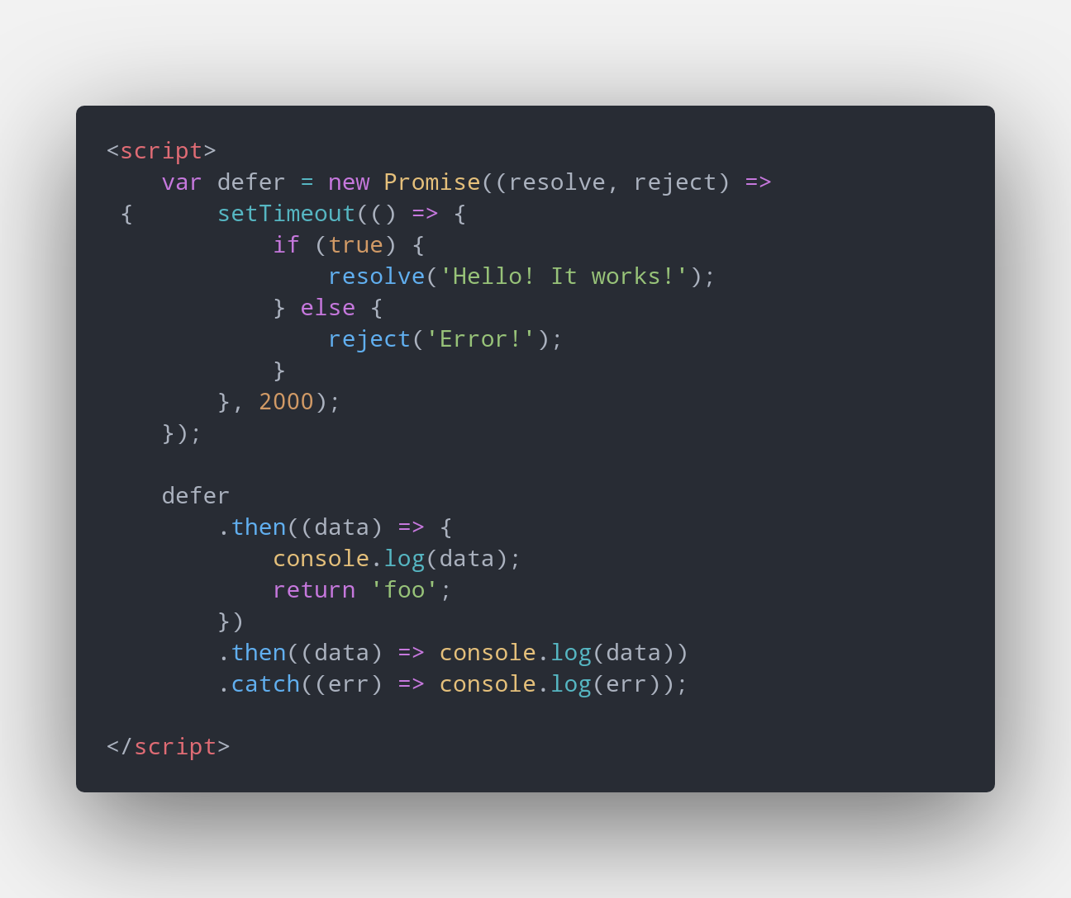
JS - ES6
Promises
The Promise object represents the eventual completion (or failure) of an asynchronous operation, and its resulting value.
https://developer.mozilla.org/en-US/docs/Web/JavaScript/Reference/Global_Objects/Promise

Slide 55
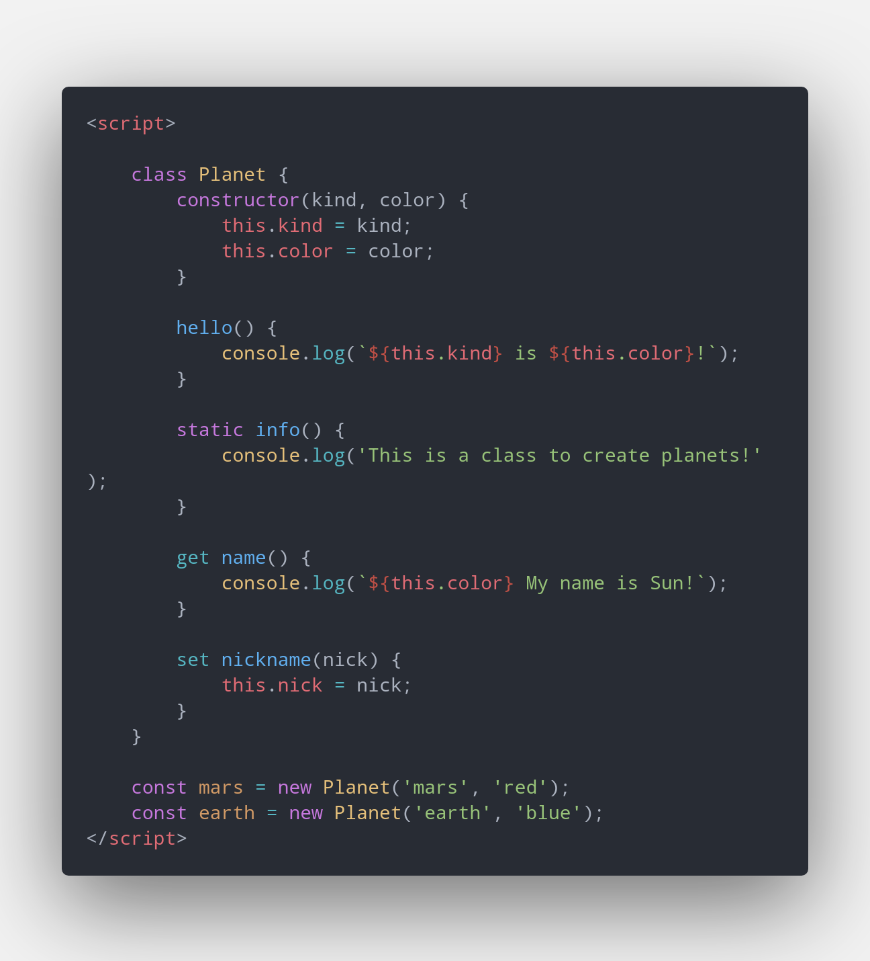
JS - ES6
Classes
The class declaration creates a new class with a given name using prototype-based inheritance.
https://developer.mozilla.org/en-US/docs/Web/JavaScript/Reference/Statements/class

Slide 56
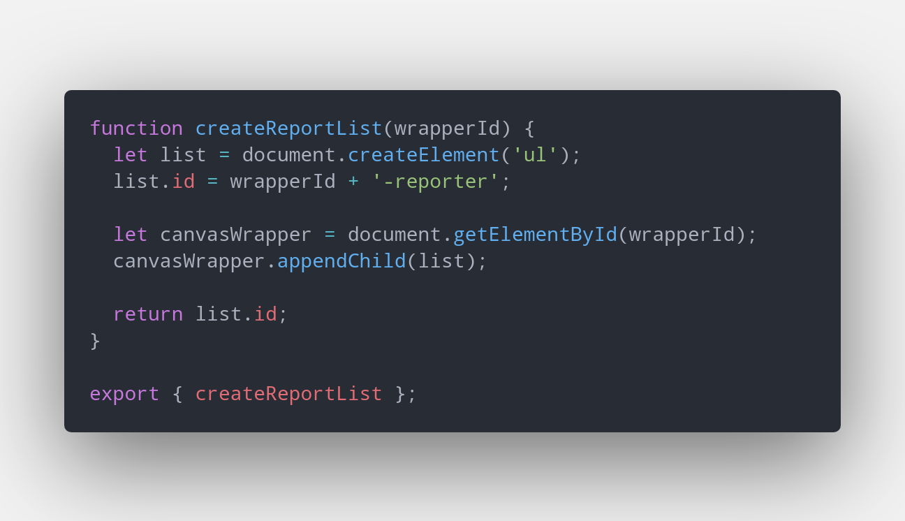
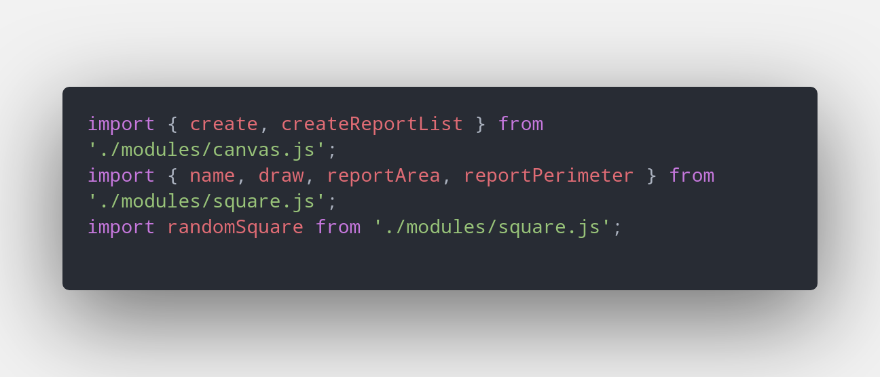
JS - ES6
Modules
modules help you to organize your JS project improving maintainability and development velocity
export
import

Slide 57
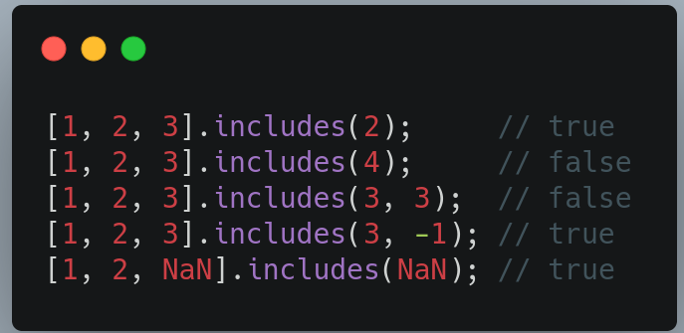
JS - ES7
Array.prototype.includes
The includes() method determines whether an array includes a certain value among its entries, returning true or false as appropriate.
https://developer.mozilla.org/en-US/docs/Web/JavaScript/Reference/Global_Objects/Array/includes

Slide 58
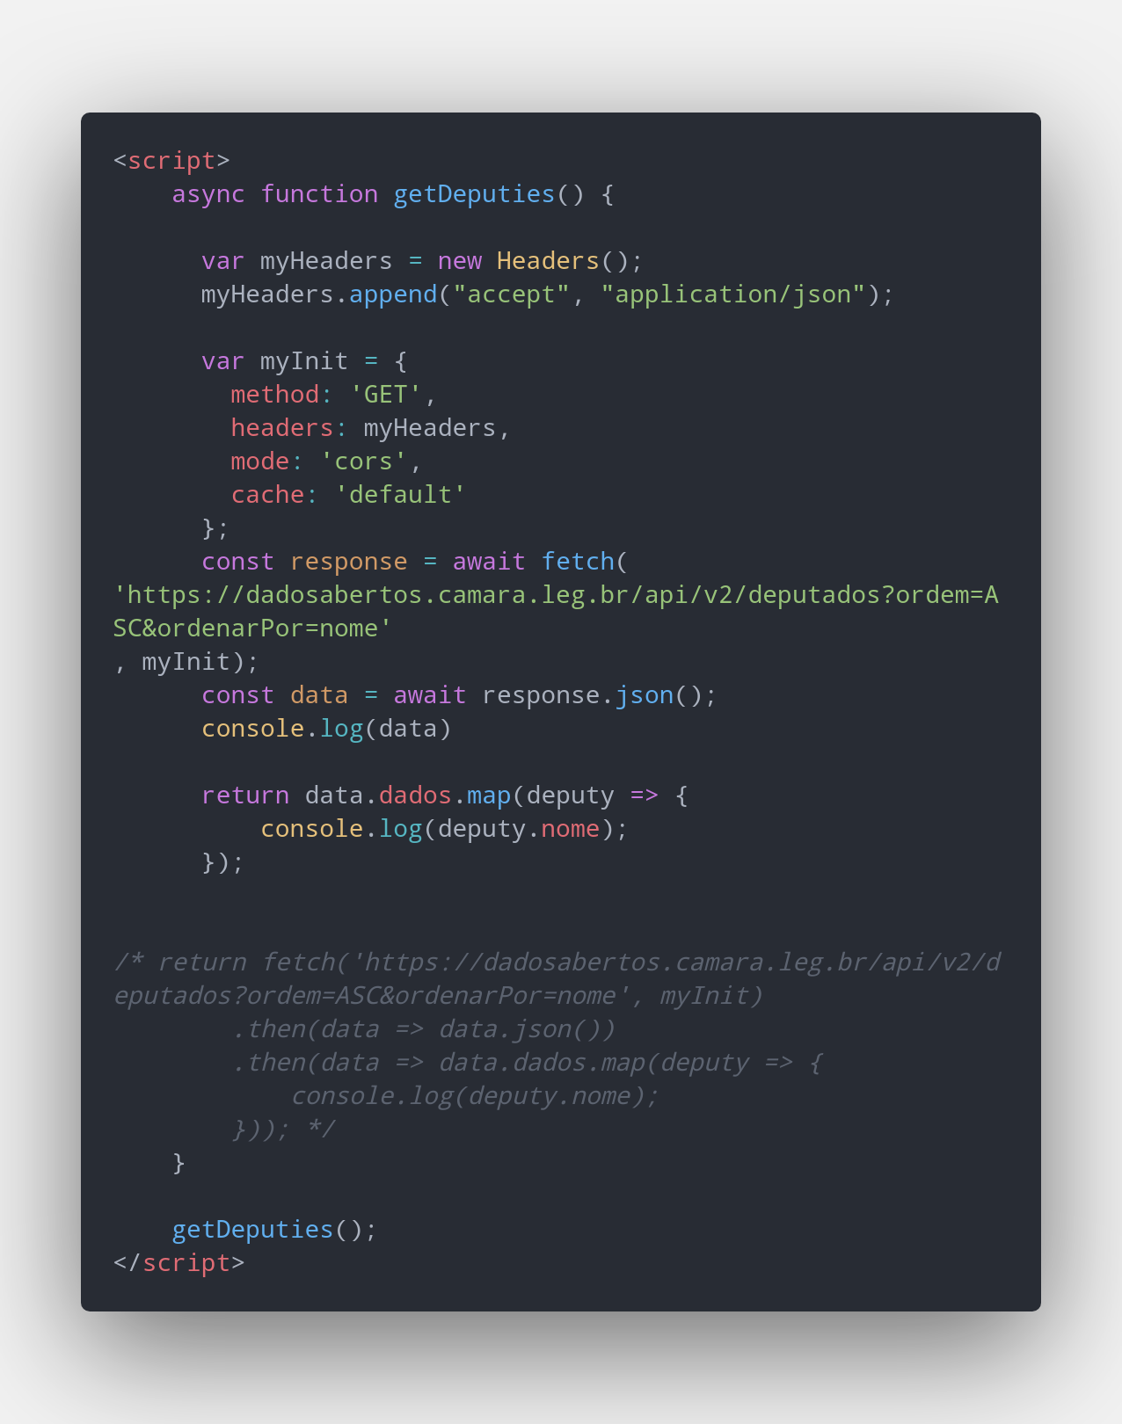
JS - ES8
Async/Await
An async function is a function declared with the async keyword. Async functions are instances of the AsyncFunction constructor, and the await keyword is permitted within them.
The async and await keywords enable asynchronous, promise-based behavior to be written in a cleaner style, avoiding the need to explicitly configure promise chains.
https://developer.mozilla.org/en-US/docs/Web/JavaScript/Reference/Statements/async_function

Slide 59
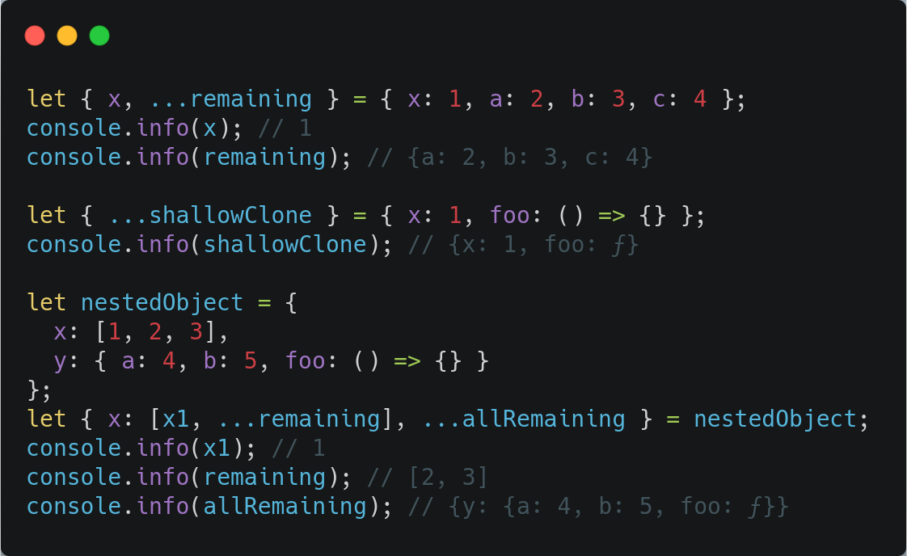
JS - ES9
spread operator obj
Object Rest/Spread Properties is an approved proposal for ES2018 (ES9) specification that was created by Sebastian Markbåge. This proposal provides the ability to use rest and spread operators on top of objects.
https://www.javascripttutorial.net/es-next/javascript-object-spread/

Slide 60

JS - ES10
Array.prototype.flat
The flat() method creates a new array with all sub-array elements concatenated into it recursively up to the specified depth.
https://developer.mozilla.org/pt-BR/docs/Web/JavaScript/Reference/Global_Objects/Array/flat

Slide 61

JS - ES11
nullish coalescing operator, ??
The nullish coalescing operator, ??, returns its right-hand side operand when its left-hand side is null or undefined. This contrasts with the || operator, which would return "string" for all "falsy" values, such as the ones below.
https://developer.mozilla.org/en-US/docs/Web/JavaScript/Reference/Operators/Nullish_coalescing_operator

Slide 62

JS - ES12
Promise.any
Promise.any() takes an iterable of Promise objects. It returns a single promise that resolves as soon as any of the promises in the iterable fulfills, with the value of the fulfilled promise. If no promises in the iterable fulfill (if all of the given promises are rejected), then the returned promise is rejected with an AggregateError, a new subclass of Error that groups together individual errors.
https://developer.mozilla.org/en-US/docs/Web/JavaScript/Reference/Global_Objects/Promise/any

Slide 63

JS
Exercise - Lets create our version of the developer score

Slide 64
JS
Activity A3
- Create your own version of the developer score
Some Ideas to improve the app!! https://docs.google.com/document/d/1vJbPzj69Uqc8J867jfJ-at_NUfoN7sn3SW-SXyK6n5Q/edit

Slide 65

OUR ROADMAP

Slide 66


TypeScript
TypeScript (TS) is an open-source programming language developed and maintained by Microsoft. It is a strict syntactical superset of JavaScript and adds optional static typing to the language. TypeScript is designed for development of large applications and transcompiles to JavaScript.[4] As TypeScript is a superset of JavaScript, existing JavaScript programs are also valid TypeScript programs.
TS 0.8 is published
TS
1.0
TS
2.0
TS
3.0
TS
3.9
TS
4.0
TS
4.4
OCT
2012
APR 2014
SEP 2016
JUL 2018
May 2020
Ago 2020
Ago 2021
[1] https://en.wikipedia.org/wiki/TypeScript

Slide 67

TypeScript - Why?
1. Code easier to understand
2. Code easier and faster to implement
3. Code easier to refactor
4. Less bugs
[1] https://medium.com/javarevisited/top-10-free-typescript-courses-to-learn-online-best-of-lot-44bce9da41d1
[2]https://medium.com/@jtomaszewski/why-typescript-is-the-best-way-to-write-front-end-in-2019-feb855f9b164

Slide 68
TypeScript
Exercise
Let’s create our first TS code.
Requirements
yarn global add typescript

Slide 69
TypeScript - Basic TS Features
Basic Types
type | example | description
number | 5, -7, 10.4 | integers or floats
string | “hi”, ‘hello’ | all text values
boolean | true, false | true OR false
object | {age:13, name:’danilo’} | any JS object
array | [1, 2, 3] | any JS array value
tuple | [1,2] | added by TS. Fixed-length array
Enum | enum {NEW, OLD} | added by TS. Global constant identifiers
any | * | any kind of value

Slide 70
TypeScript
Exercise
Let’s explore the all the basic types of TS.

Slide 71


TypeScript - Basic TS Features
UNION and LITERAL types
With Union you can combine types.
With literal type you can specify what the string the variables accept.

Slide 72
TypeScript
Exercise
Let’s explore the literal and union types.

Slide 73


TypeScript - Basic TS Features
Function Types & Callbacks
you can define what type the function will return
You can define the type being as function to type a callback.

Slide 74
TypeScript
Exercise
Let’s explore functions and callbacks

Slide 75


TypeScript - Basic TS Features
“unknown” and “never” types
The never type represents the type of values that never occur.
while void can receive null or undefined, never CAN NOT receive any value.
unknown is the type-safe counterpart of any.
Anything is assignable to unknown, but unknown isn’t assignable to anything but itself and any without a type assertion or a control flow based narrowing. Likewise, no operations are permitted on an unknown without first asserting or narrowing to a more specific type.

Slide 76
TypeScript
Exercise
Let’s explore the unknown and never types.

Slide 77

TypeScript - Basic TS Features
Generics
The implementation of generics in Typescript give us the ability to pass in a range of types to a component, adding an extra layer of abstraction and re-usability to your code. Generics can be applied to functions, interfaces and classes in Typescript.
[1] https://www.typescriptlang.org/docs/handbook/generics.html

Slide 78
TypeScript
Exercise
Let’s explore generic types

Slide 79

OUR ROADMAP

Slide 80
Caution!
THe slides below are under review

Slide 81


ReactJS
React (also known as React.js or ReactJS) is an open-source JavaScript library for building user interfaces. [1]
React 0.3.0 is published
React
0.4.0
React
0.5.0
React
0.8.0
React
0.9.0
React
0.10.0
React
0.11.0
React
0.12.0
React
0.13.0
React
0.14.1
React
15.0.0
React
16.0.0
React
16.8.0
hooks
React
16.13.0
React
17.0.0
React
17.0.2
MAY
2013
JUL 2013
OCT 2013
DEC 2013
FEV 2014
MAR 2014
JUL 2014
NOV 2014
MAR 2015
OCT 2015
APR 2016
SET 2017
FEB 2019
FEB 2020
Oct 2020
Oct 2020
[1] https://en.wikipedia.org/wiki/React_(web_framework)

Slide 82

ReactJS
React are splitted on two main libs:
React.js (core)
React-dom.js
Lets try replicate this on CodePen
[1] https://en.wikipedia.org/wiki/React_(web_framework)

Slide 83

ReactJS - Create-React-App Project
Set up a modern web app by running one command.
[1] https://create-react-app.dev/

Slide 84

ReactJS - JSX
It is called JSX, and it is a syntax extension to JavaScript. We recommend using it with React to describe what the UI should look like. JSX may remind you of a template language, but it comes with the full power of JavaScript.
React embraces the fact that rendering logic is inherently coupled with other UI logic
https://reactjs.org/docs/introducing-jsx.html

Slide 85


ReactJS - Class Based Component

Slide 86

ReactJS - Component State
State is similar to props, but it is private and fully controlled by the component.

Slide 87

ReactJS - Component LifeCycle
[1] https://github.com/wojtekmaj/react-lifecycle-methods-diagram
Notes:
Pure and has no side effects:
It means you shouldn’t try to touch the DOM, fire AJAX requests, and in general do something a user would notice there
https://twitter.com/dan_abramov/status/981866109136719874

Slide 88
ReactJS - Component LifeCycle
Exercise
Let’s explore the component lifecycle.

Slide 89

ReactJS - Conditional Rendering
In React, you can create distinct components that encapsulate behavior you need. Then, you can render only some of them, depending on the state of your application.

Slide 90

ReactJS - Lists and Keys
Lists in React is very similar with lists in JS.
Keys
Keys help React identify which items have changed, are added, or are removed. Keys should be given to the elements inside the array to give the elements a stable identity.
Avoid to use Index! It can impact performance
codepen link

Slide 91
ReactJS - Lifting State Up
Often, several components need to reflect the same changing data. We recommend lifting the shared state up to their closest common ancestor.
A
B
C

Slide 92
ReactJS - Composition vs Inheritance
Strategies to reuse Componentes
Containment
Specialization
React has a powerful composition model, and we recommend using composition instead of inheritance to reuse code between components.
Notes:
Sometimes we think about components as being “special cases” of other components. For example, we might say that a WelcomeDialog is a special case of Dialog.
In React, this is also achieved by composition, where a more “specific” component renders a more “generic” one and configures it with props:

Slide 93

ReactJS - Context
Context provides a way to pass data through the component tree without having to pass props down manually at every level.
https://medium.com/reactbrasil/entendendo-a-context-api-do-react-criando-um-componente-de-loading-a84f84007dc7

Slide 94

ReactJS - Reusing Code
High Order Component
A higher-order component (HOC) is an advanced technique in React for reusing component logic. HOCs are not part of the React API, per se. They are a pattern that emerges from React’s compositional nature.
Concretely, a higher-order component is a function that takes a component and returns a new component.
Example
HOC (withstorage)
Using HOC
https://levelup.gitconnected.com/understanding-react-higher-order-components-by-example-95e8c47c8006

Slide 95

ReactJS - Reusing Code
Render Prop
The term “render prop” refers to a technique for sharing code between React components using a prop whose value is a function.
A component with a render prop takes a function that returns a React element and calls it instead of implementing its own render logic.
Example
WRAPPER (storage handler)
Using Wrapper
https://levelup.gitconnected.com/understanding-react-render-props-by-example-71f2162fd0f2

Slide 96

ReactJS - Reusing Code
Props Drilling
Prop drilling (also called "threading") refers to the process you have to go through to get data to parts of the React Component tree.

Slide 97

ReactJS - Reusing Code
WRAPPER HELL
https://levelup.gitconnected.com/understanding-react-render-props-by-example-71f2162fd0f2

Slide 98

ReactJS - Hooks
Hooks are a new addition in React 16.8. They let you use state and other React features without writing a class.
It’s hard to reuse stateful logic between components
Complex components become hard to understand
Classes confuse both people and machines
Hooks let you use more of React’s features without classes.
Notes:
It’s hard to reuse stateful logic between components
React doesn’t offer a way to “attach” reusable behavior to a component (for example, connecting it to a store). Wrapper Hell

Slide 99


ReactJS - Functional Based Component

Slide 100
ReactJS - Hooks “Lifecycle”
Exercise
Let’s simulate the component lifecycle using hooks.

Slide 101
ReactJS - Using a React to consume API
Exercise
Lets try to list all users from this endpoint
https://jsonplaceholder.typicode.com/users
LINK: https://codesandbox.io/s/fetch-bipc9

Slide 102

ReactJS - Tic Tac Toe
board
Thinking in React. Lets build “joga da velha”
game
panel
square

Slide 103
ReactJS - Tests
You can test React components similar to testing other JavaScript code.
There are a few ways to test React components. Broadly, they divide into two categories:
Rendering component trees in a simplified test environment and asserting on their output. We will focus on this one.
Running a complete app in a realistic browser environment (also known as “end-to-end” tests).
To test our beloved React components, we will use JEST and ENZYME powerful libs.

Slide 104
ReactJS - Tests (JEST and enzyme)
Jest (facebook creation)
JEST is a JavaScript unit testing framework, used by Facebook to test services and React applications.
Jest acts as a test runner, assertion library, and mocking library. You follow the structure:
describe -> it -> expect
Enzyme (Airbnb creation)
Enzyme is a JavaScript Testing utility for React that makes it easier to assert, manipulate, and traverse your React Components’ output. Main functions: shallow, mount and render;
https://medium.com/codeclan/testing-react-with-jest-and-enzyme-20505fec4675
Notes:
Jest and Enzyme
Both Jest and Enzyme are specifically designed to test React applications, Jest can be used with any other Javascript app but Enzyme only works with React.
Jest can be used without Enzyme to render components and test with snapshots, Enzyme simply adds additional functionality.
Enzyme can be used without Jest, however Enzyme must be paired with another test runner if Jest is not used.

Slide 105
ReactJS - Using a React to consume API
Exercise
Lets use and understand how JEST and enzyme works

Slide 106
ReactJS - Using a React to consume API
Exercise
Lets try to adds test to our calculator

Slide 107

OUR ROADMAP

Slide 108

It is time! Lets develop Tafeito
FIGMA LINK

